Slide 1


Slide 2



Slide 3

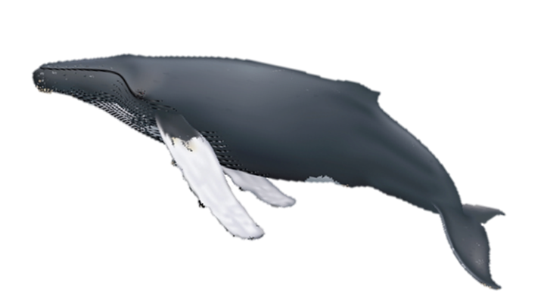
Sanctuary Splash!
Acoustics of Humpback Whales
Developed by:
Olympic Coast National Marine Sanctuary

Slide 4
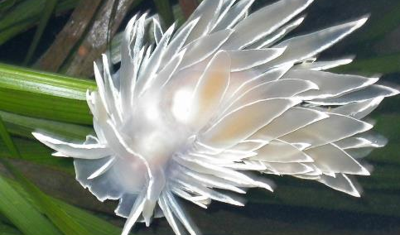
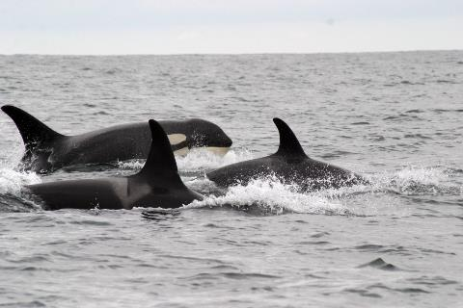
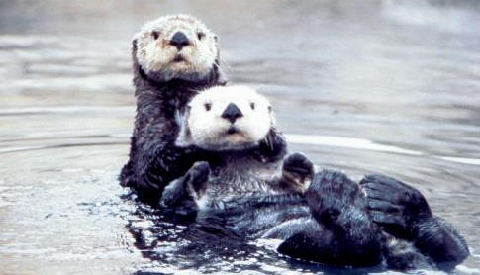
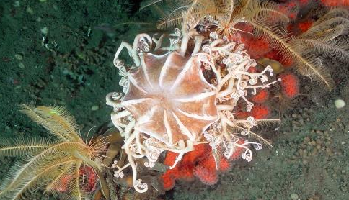
National Marine Sanctuaries
“America’s Ocean and Great Lakes Treasures”
Notes:
First, I want to tell you a little bit about national marine sanctuaries! Few places on the planet can compete with the diversity of the National Marine Sanctuary System, which protects America’s most incredible natural and cultural marine resources.
Sanctuaries are America’s Ocean and Great Lake treasures.

Slide 5
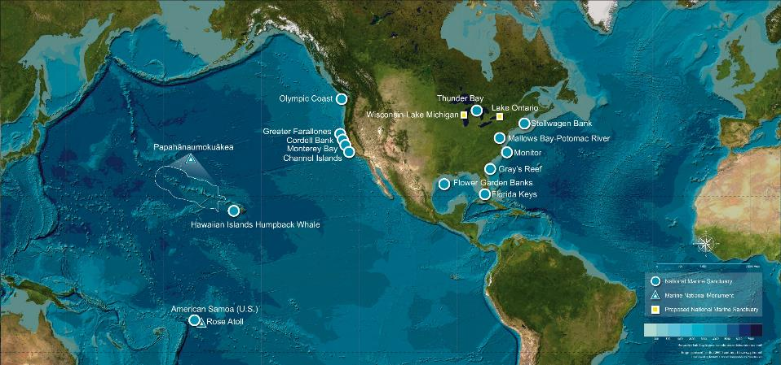
Where are national marine sanctuaries?
Notes:
NOAA’s Office of National Marine Sanctuaries protects a network of underwater treasures encompassing more than 600,000 square miles of marine and Great Lakes waters. The network includes a system of 14 national marine sanctuaries and Papahānaumokuākea (Pa-pa-hah-now-mo-koo-ah-keh-ah) and Rose Atoll marine national monuments.
Here you can see the blue dots on the map. Each one represents a national marine sanctuary. The blue triangles represent our marine national monuments.
The yellow boxes represent newly proposed areas.
Map graphic: https://sanctuaries.noaa.gov/

Slide 6

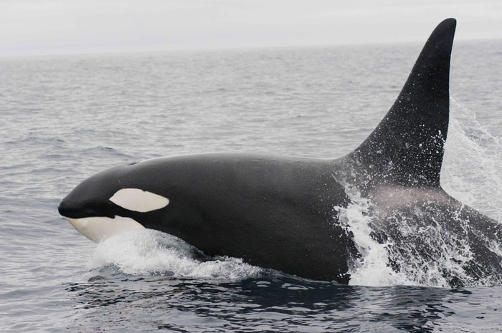
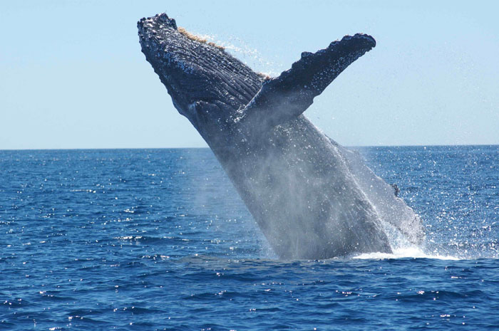
Acoustics of cetaceans in the wild
Notes:
Today we will talk about cetaceans – a grouping of aquatic mammals that include toothed and baleen whales, like the orca whale and humpback whale seen here.
Specifically, we are going to talk about the Acoustics of Cetaceans in the wild. “Acoustics” is the science that involves sounds and sound waves.

Slide 7
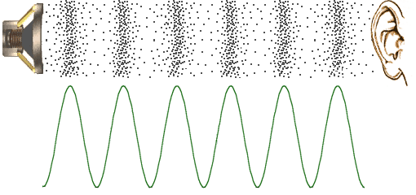
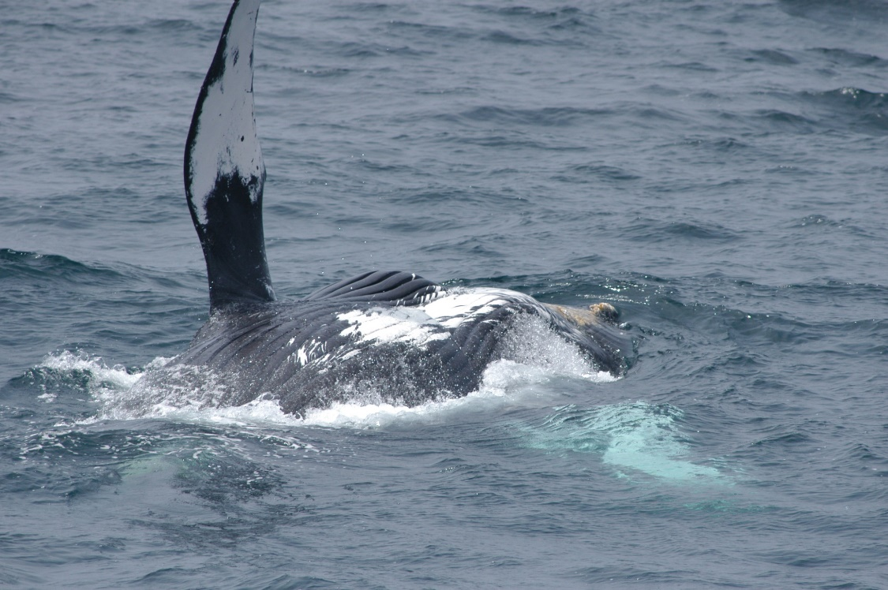
What is vocalization?
https://www.mediacollege.com/audio/images/loudspeaker-waveform.gif
Notes:
What is vocalization? It is any audible communication between two organisms. Communication can occur without speaking, such as body language or in the case of whales, peck slaps and fluke slaps. But vocalization occurs through vibrations that our brains then “decode” as sound. These vibrations move through matter, which is made up of molecules. The molecules transfer energy to one another.
You can actually feel these vibrations! Put your hand on your chest and say your name or hum. Can you feel the vibrations inside of your body?
Photo credits:
http://www.mediacollege.com/audio/images/loudspeaker-waveform.gif
NOAA/OCNMS

Slide 8

What is a wave?
Notes:
Sound waves are longitudinal waves. Using a slinky stretched out over a flat surface, we can compress one side of the slinky and watch the compression travel through the slinky to the other side.
(Click on the play arrow to show the brief video demonstration)

Slide 9

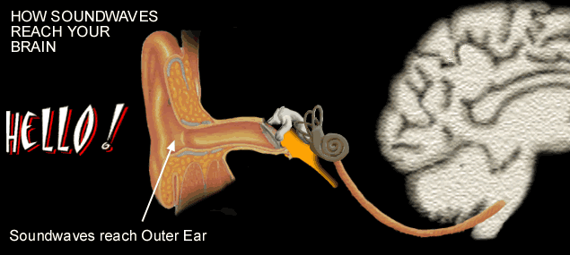
How do humans communicate?
https://d132a.files.wordpress.com/2008/07/sound_conduction1.gif
Notes:
As the sound waves travel, our outer ear funnels sound from the air into our inner ear. Our ear canal receives vibrations via the eardrum, which amplifies the sound. Then the vibrations pass through our inner ear, which is made up of three little bones. And from there, the vibrations are translated by our brains to make sounds.
Whales don’t have the same structure as us. The inner ear is different for us and them, even location, compared to our anatomy, is different.
Photo credit:
https://d132a.files.wordpress.com/2008/07/sound_conduction1.gif

Slide 10
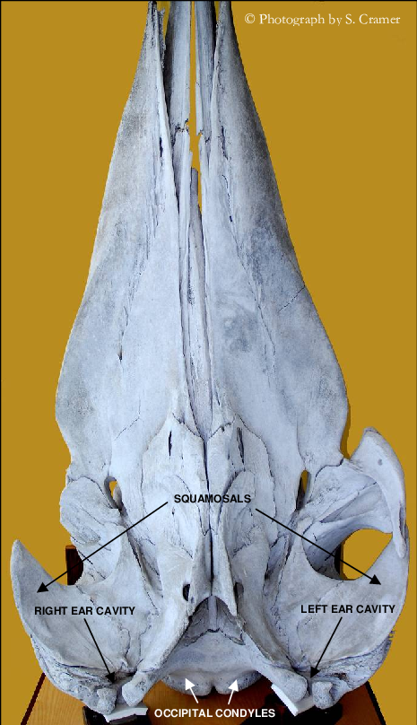
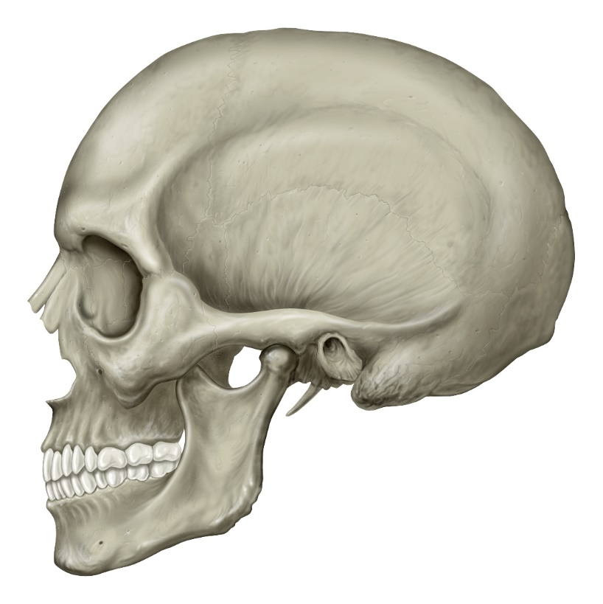
Ear Cavity
Notes:
Look at the human skull on the left. We can see the ear cavity behind the connection of our lower jaw.
(click for label)
But we don’t rely on our lower jaw to pick up sound waves since we have our outer ear that works as a funnel for the sound.
Now look at the whale skull. From this view, we are only looking at the upper skull/jaw bone. The lower jaw bone would connect near each of the ear cavity locations.
(click for label)

Slide 11

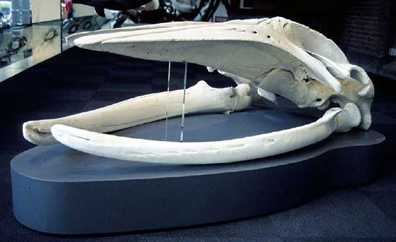

https://museumsvictoria.com.au/bioinformatics/mammals/images/novaside.jpg
Notes:
The upper left hand image is of a full humpback whale skull. The bottom right hand image is the partial skull showing the ear canals. You can tell that the ear canals and the jaw bone are right next to each other when the full skull is complete!
(Click)
Photo credit: https://museumsvictoria.com.au/bioinformatics/mammals/images/novaside.jpg

Slide 12
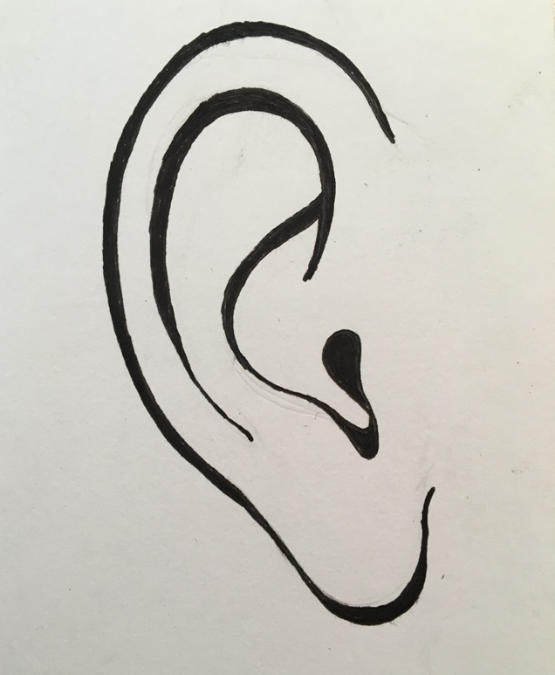
Do whales have an outer ear flap?
A) Yes
B) No
Notes:
We saw the difference between a human skull and a whale skull. What about the ear? Touch the soft part of your ear. That’s your outer ear flap.
Do you think whales have an outer ear flap? Choose A if you think “yes, whales do have an outer ear flap” or B if you think, “no, whales do not have an outer ear flap”.

Slide 13
Whale and human ear anatomy?
Credit: teachers’domain
Notes:
The answer is no, whales do not have an exposed outer ear flap like humans. And unlike our ears, their ear canal is not open to their inner ear. On the left is a diagram of a whale ear and on the right is a human ear. Whales have an oily mucus that surrounds the inner ear. For humans, the inner ear is surrounded by bone. Look for other differences between whale and human ears! Write down your observations. Your observations can include similarities between whale and human ears or differences.
There are a lot of differences between whale ears and human ears like how they don’t have an outer ear flap and their inner ear is surrounded by an oily mucus while ours is surrounded by bone. But there are also quite a few similarities, for instance the majority of the anatomy is still very similar. We both have ear canals, cochlea, and auditory nerves.
Illustration credit: teachers’domain
Lets compare these inner ear structures of a whale and a human Learning Ob 5

Slide 14
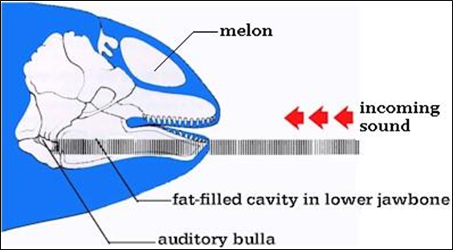
Credit: Scienceblog.com
Notes:
Another difference between us and whales is that whales have a fat filled cavity located in their jaw bones that detect vibrations. After sound travels through the jaw, it then heads to a compartment that is called the “bulla”, much like our inner ear. The bulla is what eventually transmits the vibrations to the brain so they can be interpreted as sound.
Graphic credit: Scienceblog.com

Slide 15
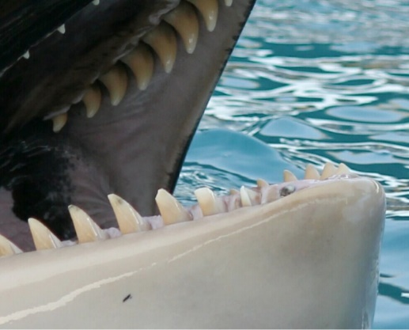
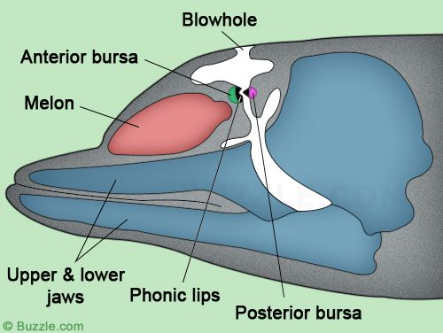
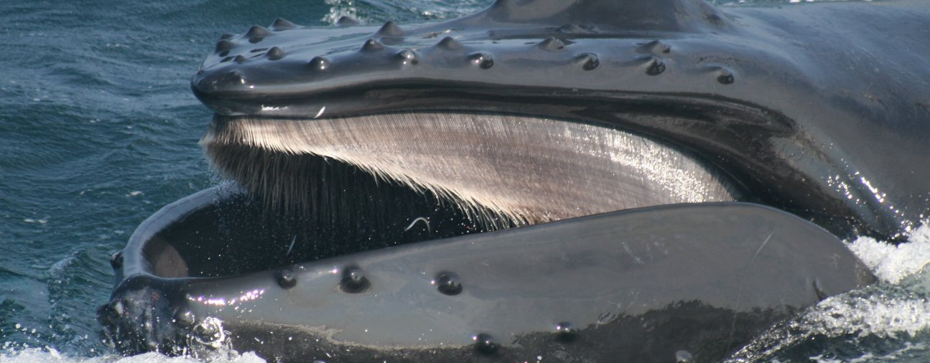
“Whale Talk”
Credit: Chris Lagergren
Credit: Buzzle.com
Credit: Whale and Dolphin Conservation
Notes:
Toothed whales, like orcas and sperm whales, have a melon (click) and sometimes use it to focus their sounds during echolocation. Other animals use echolocation too, like bats!
Baleen whales (click), like humpback and gray whales, do not typically use their sound for echolocation. Scientists have hypothesized that they could potentially do this but much more research is needed. So, baleen whales are actually considered to have more of a song.
Toothed whales are thought to produce sounds by passing air through both their trachea, which is a part of their throat, and their “phonic lips” (click), which are air sacs around the blowhole.
Baleen whales are a bit of a mystery to scientists because although they have a larynx, they have no vocal chords and when they sing, bubbles are not released from their blowholes.
Here’s a fun fact: whale noise is thought to be one of the loudest noises made by any animal on the planet! Does anyone want to guess which whale is the loudest?
The loudest sound ever recorded from an animal was produced by a blue whale! Some scientists have speculated that they may be able to remain in touch with each other over hundreds of miles.
https://www.fisheries.noaa.gov/national/outreach-and-education/fun-facts-about-wonderful-whales
Graphic credit Buzzle.com
Photo credit: (top left Chris Lagergren; bottom Whale and Dolphin Conservation)

Slide 16
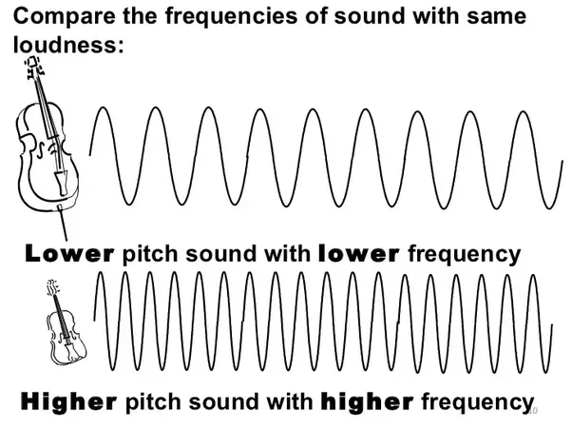
What is frequency?
Credit: Slideshare.net
Notes:
Whale vocalizations vary in intensity, wavelength, frequency, and pattern based on the behavior and purpose of the sound. High frequency sounds are usually called clicks, whistles, and squeaks (say with high squeaky tone voice); low frequency sounds are usually called grunts, moans, pulses, and tones. (say in low deep tone voice)
Baleen whales vocalize mostly through low frequency sounds, about 10-1,000 hertz. (Hz is wave cycles per second). Low frequency sounds would be similar to a cello (click). Toothed whales typically produce high-frequency sounds above 1,000 hertz. High frequency sounds would be similar to a violin (click).
Humans hear sounds best between the frequencies of 1,000 to 5,000 Hz, where human speech is centered. So some low frequency and high frequency whale vocalizations may not be audible to the human ear.
https://www.slideshare.net/guest90e7e/reflection-of-sound-part-2-presentation

Slide 17
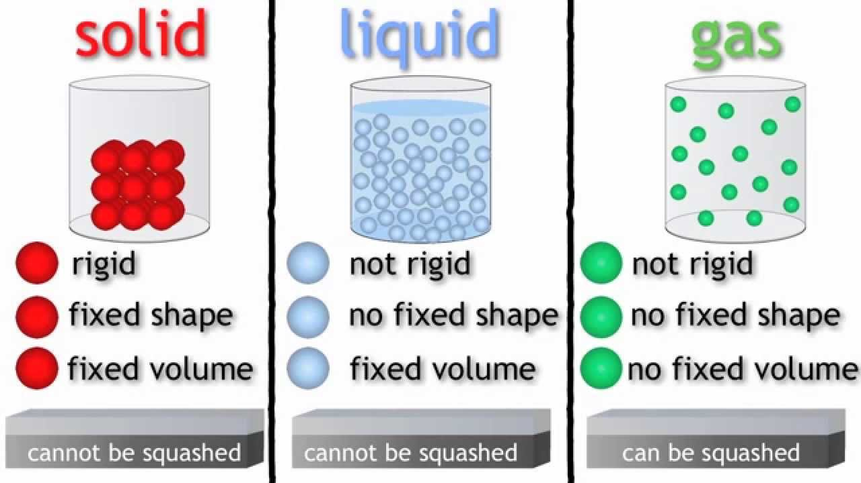
Credit: https://i.ytimg.com/vi/21CR01rlmv4/maxresdefault.jpg
Notes:
Now that we understand how whales make sounds and we learned about some of the sounds they make, let’s consider how their sounds travel in the ocean – or in liquid – versus how sound travels in other forms of matter including solid and gas.
Let’s demonstrate this through a game (Play “States of matter” 15 minute game in Sanctuary Splash: Acoustics of Cetaceans lesson plan)
Sound waves travel much more efficiently in liquid compared to gas and air. However, sound travels best through solids.
In solids, sound can travel quickly since molecules are close together and they pass sounds to one another. As the molecules spread out in different states of matter, it becomes harder for sound to travel from molecule to molecule.
Graphic credit: https://i.ytimg.com/vi/21CR01rlmv4/maxresdefault.jpg

Slide 18
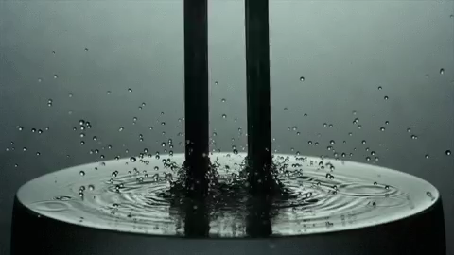
https://gifer.com/en/3nzG
Notes:
Let’s watch how sound waves travel through water with this video! (Click on the play arrow to play video)
(Conduct “Tuning fork exploration” 15 minutes activity in Sanctuary Splash: Acoustics of Cetaceans lesson plan)
(Hand out tuning forks)
We experience how sounds travel through air when we listen to noise. We can even sometimes feel it travel through solids, like how we felt the vibrations from humming or saying our names earlier. In this video of a tuning fork partially submerged in water, we can see how sound waves travel through liquid. You can see how the sound waves make ripples in the surface of the water.
Now that you have seen, felt, and heard how sound travels through different states of matter, it’s time to talk about humpback whales and how they produce sound.
(Collect tuning forks)

Slide 19

Humpback Whales
(Megaptera novaeangliae)
Credit: NOAA/OCNMS
Notes:
Humpback whales are found throughout the world’s ocean and they are probably the most well-known of baleen whales. They are best known for their vocalizations – a series of complex and repeating sequences with the characteristics of a “song”. Males are the only ones who sing and mainly do so in warm water breeding grounds (like Mexico and Hawaii). Songs are repetitive sequences that last between 20 minutes to several hours. Listen to this song!
(Click speaker icon for acoustics recording – play for 10 seconds or longer)
Males sing in warm waters, like those found in Hawaiian Islands Humpback Whale National Marine Sanctuary and Papahānaumokuākea Marine National Monument. We would hear both males and females vocalize/groan, click, squeak in warmer and colder waters of the ocean.
Females do vocalize, especially for communicating with young or during feeding as a group. Feeding generally happens in the cooler, more productive areas of the ocean, like Olympic Coast National Marine Sanctuary.
(More acoustics info at https://dosits.org/galleries/audio-gallery/marine-mammals/baleen-whales/humpback-whale/)

Slide 20
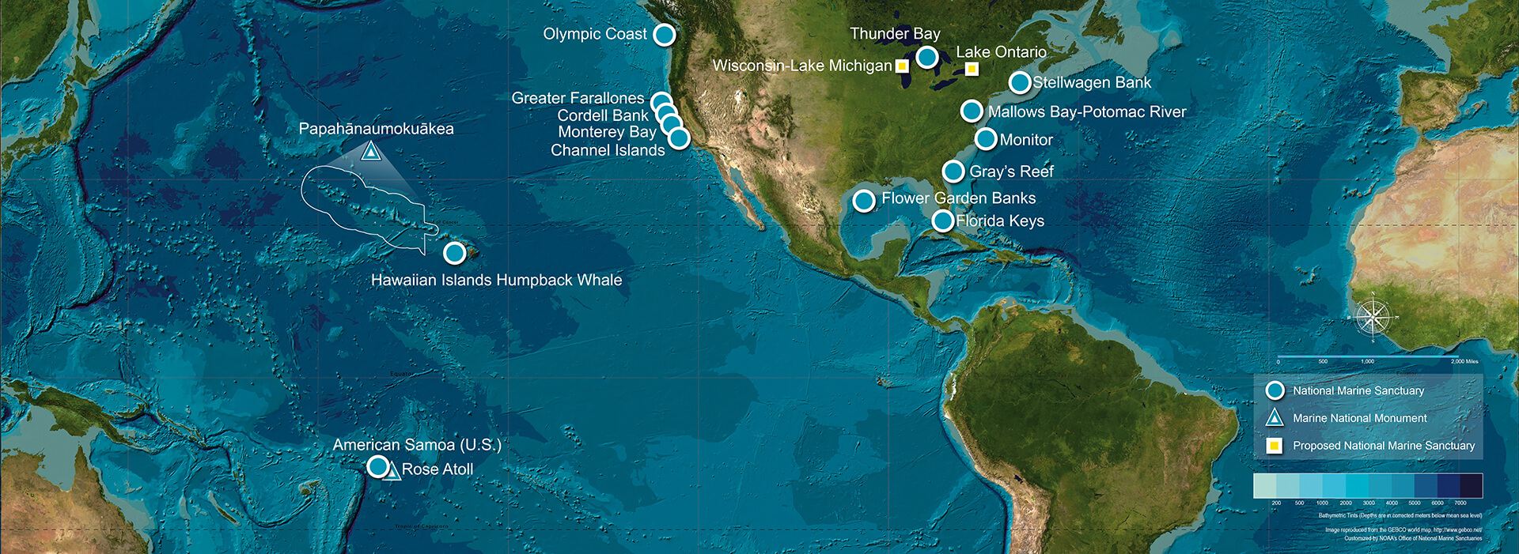
Which national marine sanctuary would you most likely hear a humpback whale sing?
Credit: NOAA
Hawaiian Islands
Olympic Coast
Monterey Bay
Thunder Bay
Notes:
Which national marine sanctuary would you most likely hear a humpback whale sing? Hawaiian Islands (click), Olympic Coast (click), Monterey Bay (click), Thunder Bay (click).
Map graphic: https://sanctuaries.noaa.gov/

Slide 21
Humpback whales are most likely to sing in this sanctuary:
A) Hawaiian Islands
Credit: NOAA
Notes:
You’d most likely hear humpback whales sing near the Hawaiian Islands, so if you said A, you were correct! This is where many humpback whales go in the winter time to mate and have their babies.
Map graphic: https://sanctuaries.noaa.gov/

Slide 22
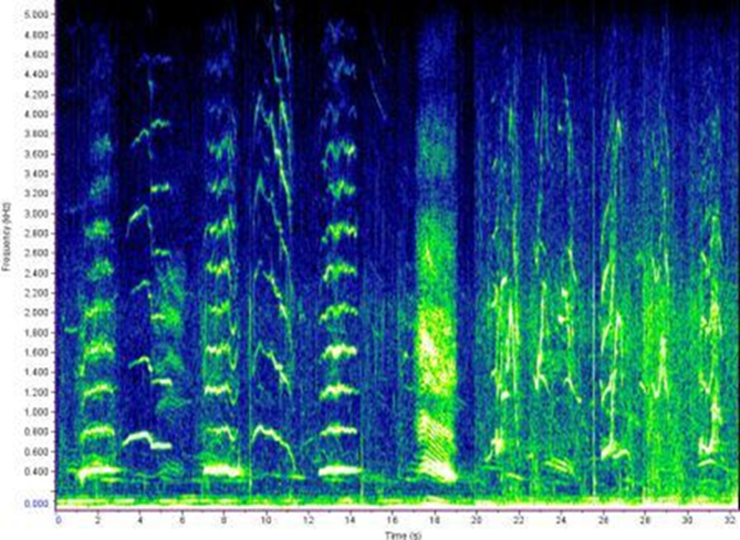
Spectrogram
A visual representation of the frequency, duration, and intensity of a sound as it changes through time.
Also called a “voiceprint” or “voicegram.”
Notes:
Whale researchers use equipment to monitor whale vocalization that was originally used by the Navy to detect submarines. Remember how we said we can’t hear some sounds that whales make? A spectrogram allows us to “see” the sounds we can’t hear.
To do this, scientists collect data through a submerged hydrophone and then monitor the sounds using software that allows them to create a spectrogram, like the one shown here.
These are visual representations of the frequency, duration, and intensity of a sound as it changes through time. Also called “voiceprints” or “voicegrams.”

Slide 23
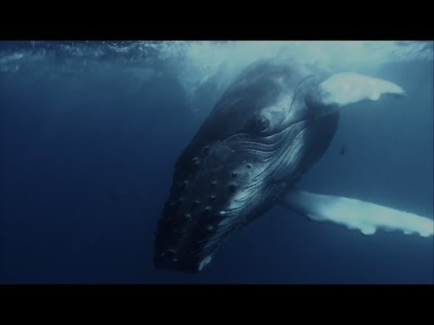
VIDEO!
Whale Songs and AI, for everyone to explore
https://www.youtube.com/watch?v=JE3-LkMqBfM&feature=youtu.be
Notes:
You can watch this this short video (4:24 minute) to learn more about whale songs, the types of scientists that study them, and the technology they use.
(Click on the play arrow or watch video at https://www.youtube.com/watch?v=JE3-LkMqBfM&feature=youtu.be)
(Following video) Are you ready to be scientists!?!
(The next few slides will provide examples of spectrograms for the “Spectrogram guessing game” 20 minutes in Sanctuary Splash: Acoustics of Cetaceans lesson plan)

Slide 24
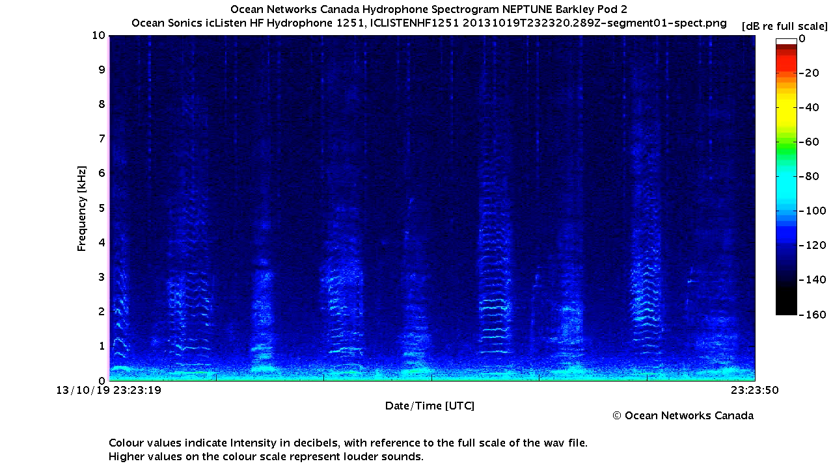
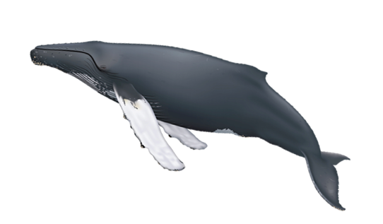
Spectrograms
Humpback Whale
https://www.openschool.bc.ca/shouting_whales/lessons/index.html#D
Notes:
Here is an example of a spectrogram graph.
The horizontal axis is called the x-axis. The vertical axis is called the y-axis. In this graph the x-axis represents time elapsed. And the y axis represents frequency in thousands of hertz, so q is actually 1,000 hertz.
There will be a pink line that will pass across the spectrogram and it will indicate which sounds are happening while you hear them.
This is what a humpback whale sounds like. (Click video.)
Spectrograms: http://openschool.bc.ca/shouting_whales/lessons/index.html#D
Learning Ob. 2

Slide 25
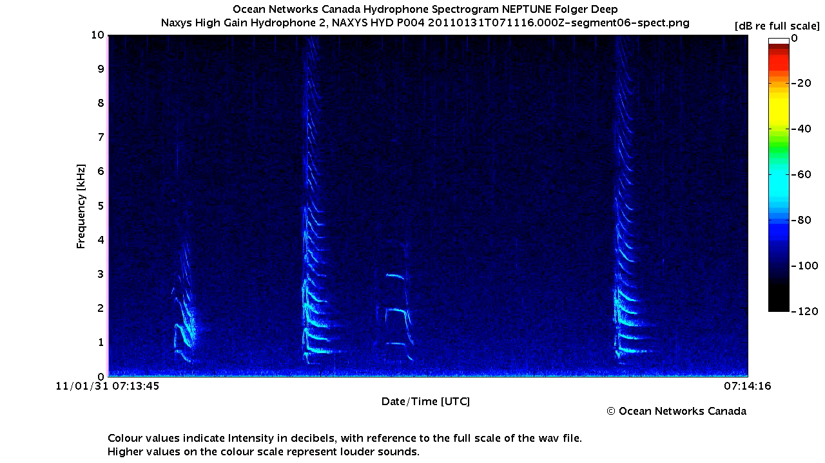
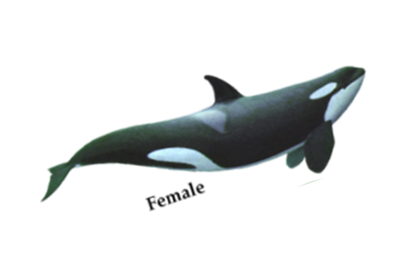
Orca
Notes:
This is what an orca sounds like.
(Click on the arrow to play the video.)
Spectrograms: http://openschool.bc.ca/shouting_whales/lessons/index.html#D

Slide 26
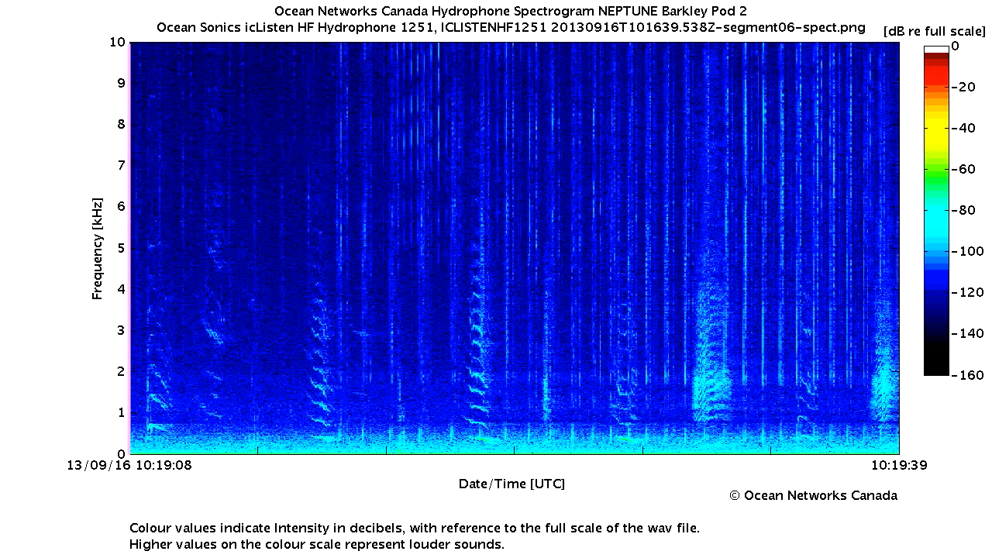
How many whales were recorded for this spectrogram?
Notes:
Now it’s your turn to be a scientist! How many whales were recorded for this spectrogram? Do you think it’s one? Do you think it’s two? Do you think it’s three?
A) one B) two C) three
(Click video)
Spectrograms: http://openschool.bc.ca/shouting_whales/lessons/index.html#D

Slide 27
Humpback and sperm whales
Notes:
This is a humpback and a sperm whale. So the correct answer is B, two whales were recorded for this spectrogram! The first whale, which you can hear vocalizing in the beginning, is a humpback whale. The second whale sound sounds like foots steps, which is a sperm whale echolocating.
Spectrograms: http://openschool.bc.ca/shouting_whales/lessons/index.html#D

Slide 28
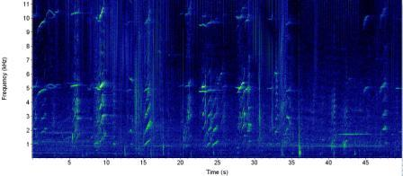
Orcas
Notes:
Now this spectrogram is a lot busier than before. This is a group of orca whales vocalizing.
(click video)
Graphic of spectrogram: NOAA

Slide 29
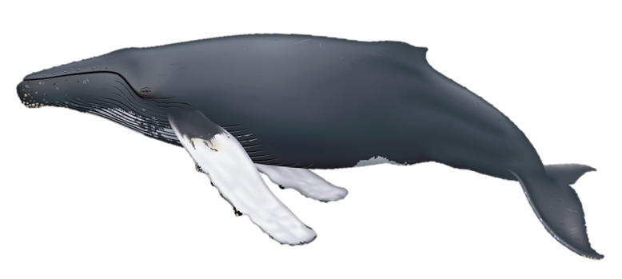

Humpback Whales
Notes:
This spectrogram is a group of humpback whales vocalizing.
(click video)
Photo and Sound: NOAA

Slide 30
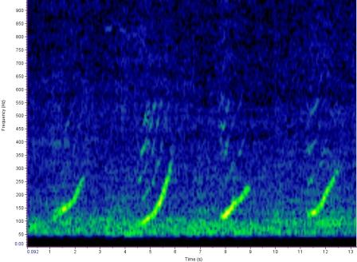
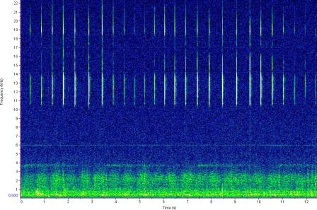
Match the sound to the spectrogram!
A)
B)
Citation: NOAA
Notes:
Now that you have heard and seen the differences between toothed and baleen whales, you get to match the sound to the spectrogram. First, listen to the recording. Then guess which spectrogram matches it.
(click sound)
I will play this once more, so go ahead and pick your answer, A or B, over the round. Soon you won’t be able to see the spectrograms, so remember your answer!
(click sound)
Pick spectrogram A or B if you think it matched the sound.
Citation: NOAA

Slide 31
North Atlantic Right Whale
Citation: NOAA
Notes:
The correct answer is A. The North Atlantic Right Whale is a baleen whale, so it has a lower pitch and “hums” to vocalize. Let’s listen to it one more time with the correct spectrogram in view.
Citation: NOAA

Slide 32
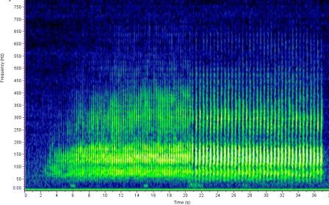
When does the sound change on the spectrogram?
Citation: NOAA
5 seconds B) 21 seconds
Notes:
This next spectrogram is a Minke whale. Minke whales are toothed whales, so they can use echolocation to get around. Listen to this spectrogram. Can you tell when the sound changes? Follow the timeline at the bottom. Do you think it happens early on, in the first 5 seconds? Or later on, 21 seconds in? I’m going to start it now!
(Click sound)
You can choose A, 5 seconds near the beginning. Or B, 21 seconds, later on in the recording.
Graphic of spectrogram: NOAA

Slide 33
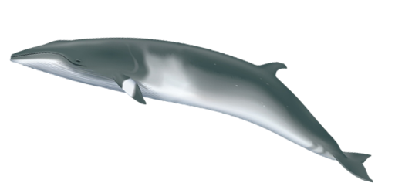
Minke Whale
Citation: NOAA
21 seconds
Notes:
Right at around 21 seconds, you can hear a noticeable difference in the sound. The sounds are closer together in the beginning because the Minke whale is approaching the hydrophone. After 21 seconds, it passes the hydrophone and the sounds become further apart.
So the correct answer is B, 21 seconds.
Graphic of spectrogram: NOAA

Slide 34
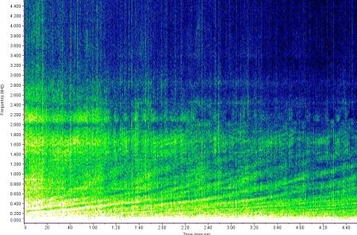
What do you think this is?
Citation: NOAA
A) Train B) Small boat C) Rock fish D) Stellar sea lion
Notes:
Hydrophones pick up other sounds besides whale vocalizations. What do you think this sound is?
(Click sound)
A) Train B) Small boat C) Rock fish D) Stellar sea lion

Slide 35
It’s a small boat!
Citation: NOAA
Notes:
This spectrogram is B, a small boat. Just one small boat creates a lot of sound! It’s important we remember that we share the ocean with other creatures and that we can affect how those creatures, like whales communicate.

Slide 36
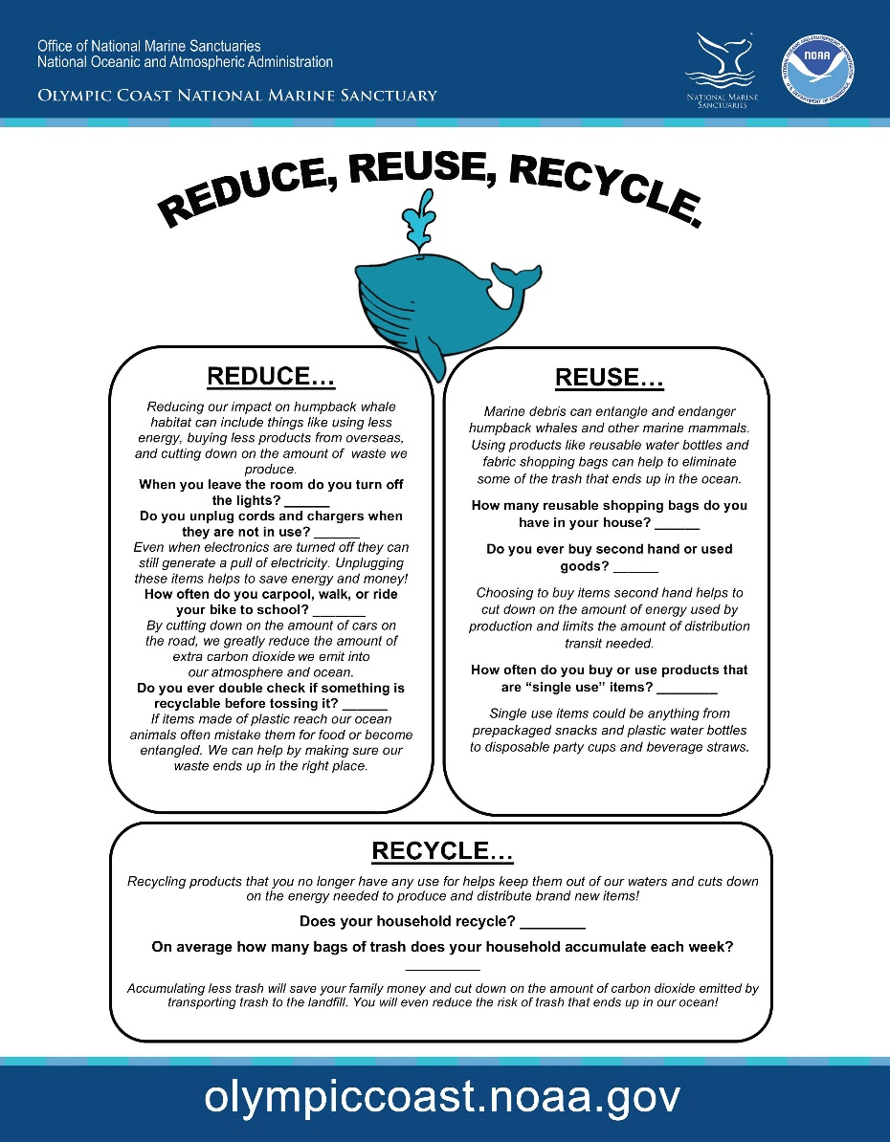
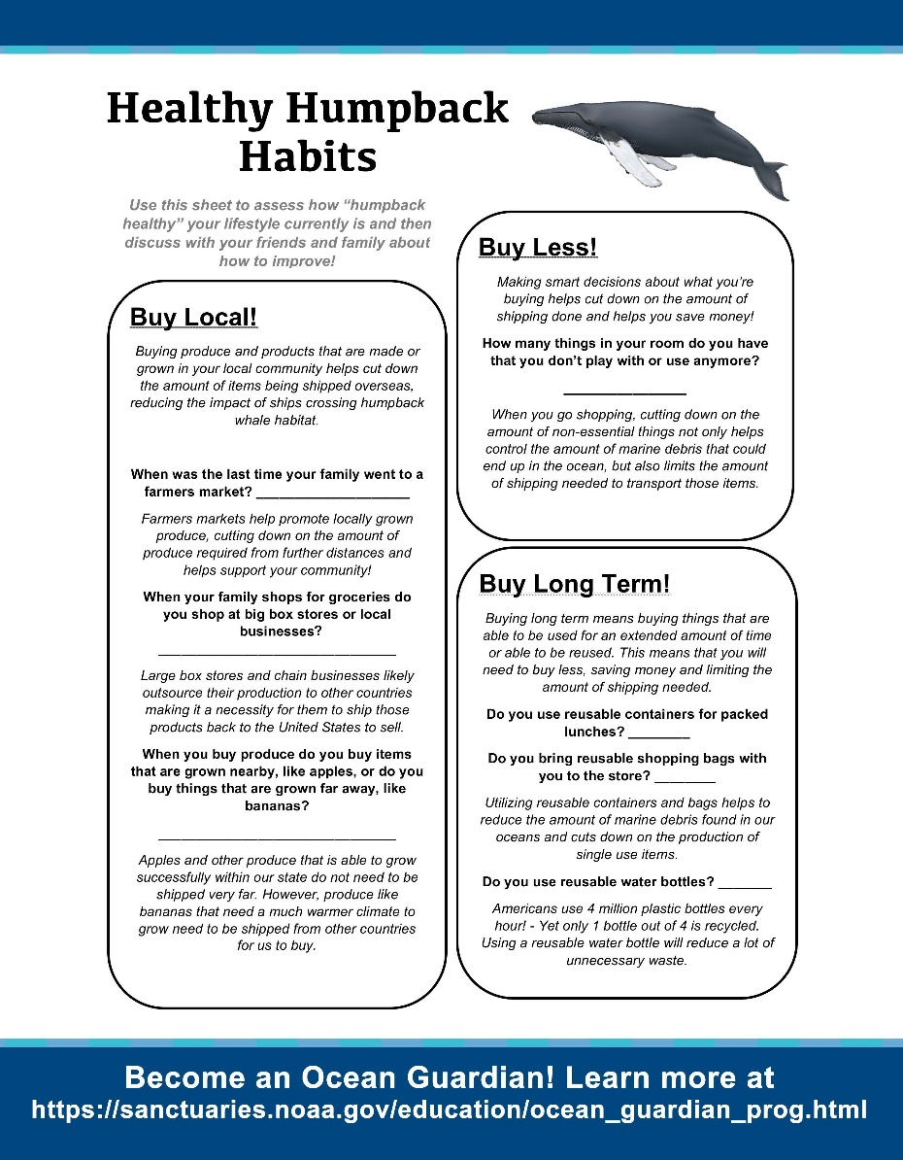
How can you promote
Healthy Humpback Habits?
Notes:
Now that we know so much about acoustics of humpback whales and other cetaceans, here is a fun worksheet to help you and your family determine some actions that you can do, or are already doing, at home to help create some healthy humpback habits!

Slide 37


http://sanctuaries.noaa.gov
http://olympiccoast.noaa.gov
Notes:
I hope you learned a lot about the acoustics of cetaceans!
Visit the sanctuaries.noaa.gov or Olympiccoast.noaa.gov to learn more!

