Slide 1
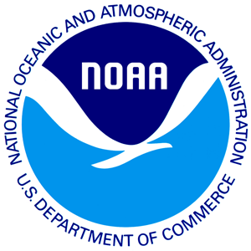
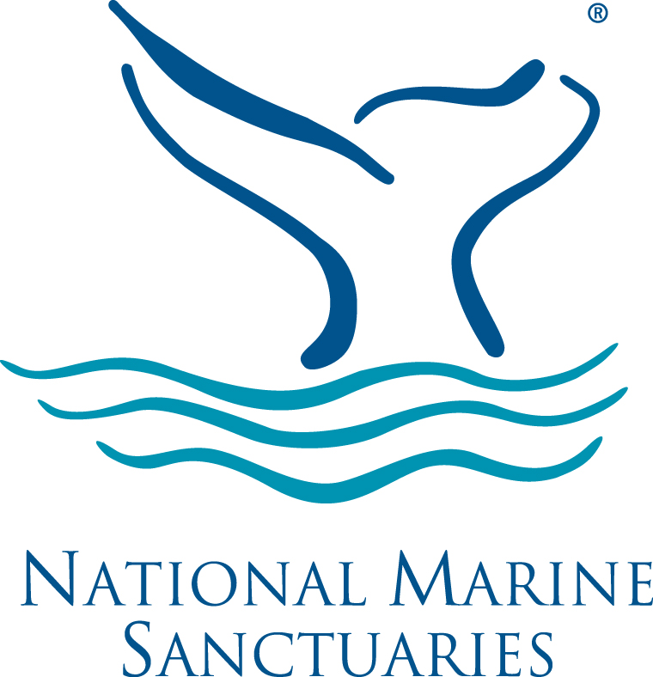
Marine Debris Toolkit Introduction to Marine Debris

Slide 2
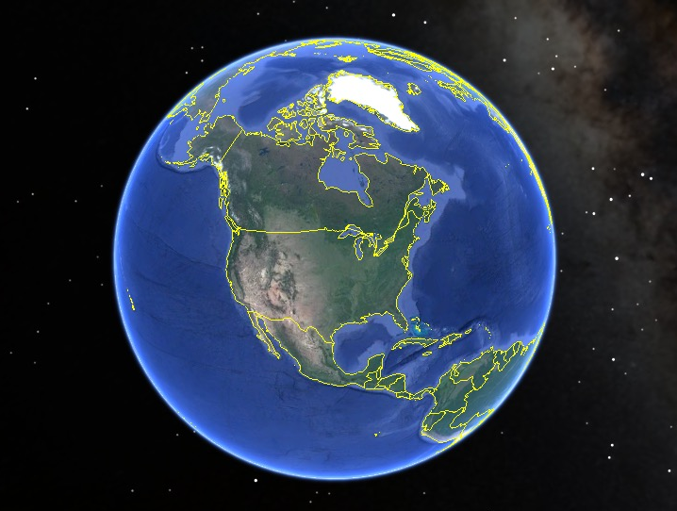
Planet Earth
Historically there are 5 named ocean basins

Slide 3
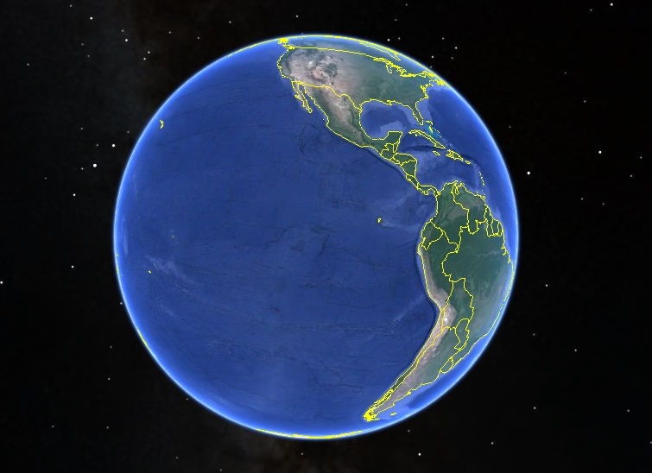
Pacific Ocean
…but these 5 ocean basins are not separate bodies of water.

Slide 4
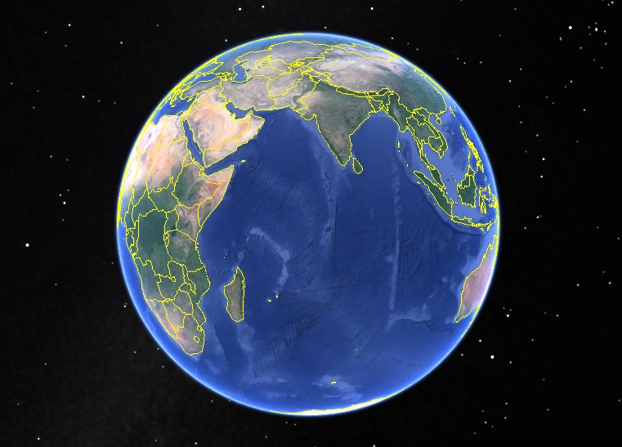
Indian Ocean
These 5 ocean basins form one continuous ocean mass.

Slide 5
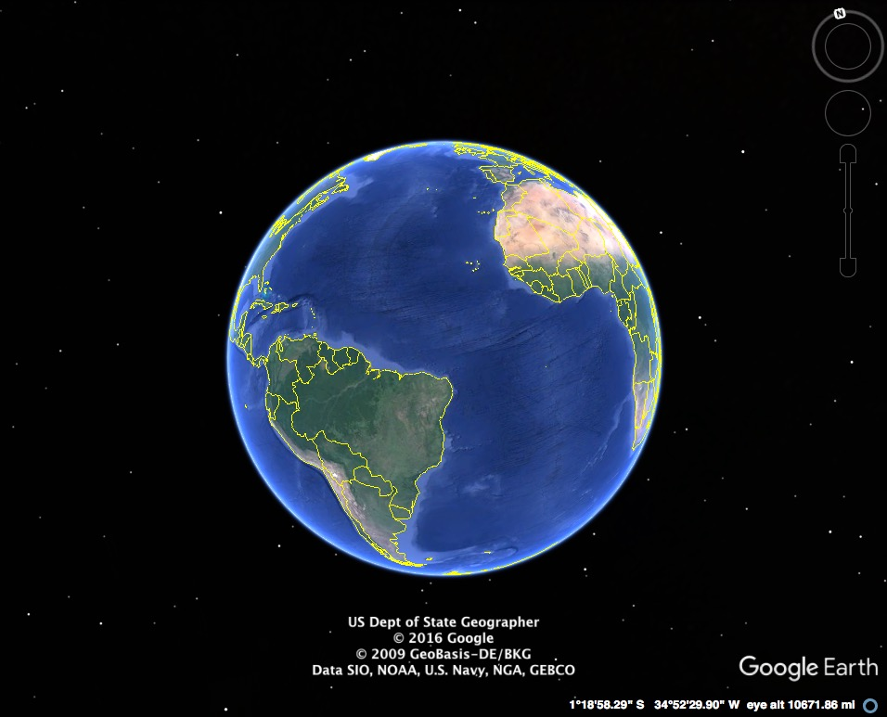
They are each part of one global ocean system.
Atlantic Ocean

Slide 6
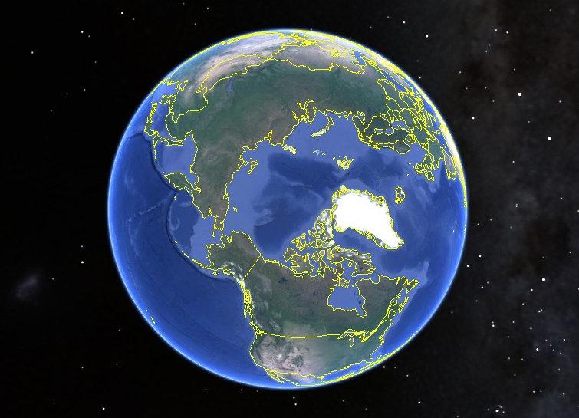
Arctic Ocean
This vast body of water covers 71% of our planet.

Slide 7
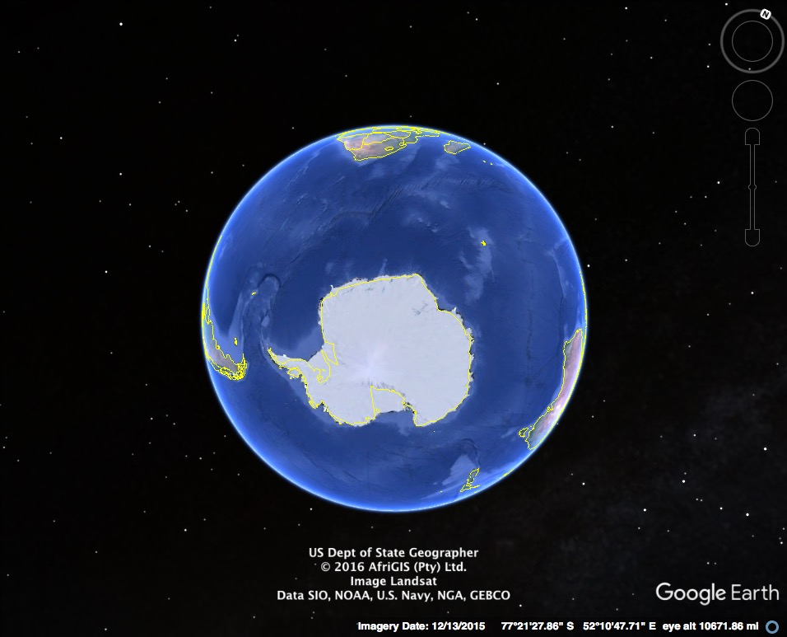
Question: Why do we call our planet “Earth” when most of the planet is covered in water?
Southern Ocean

Slide 8
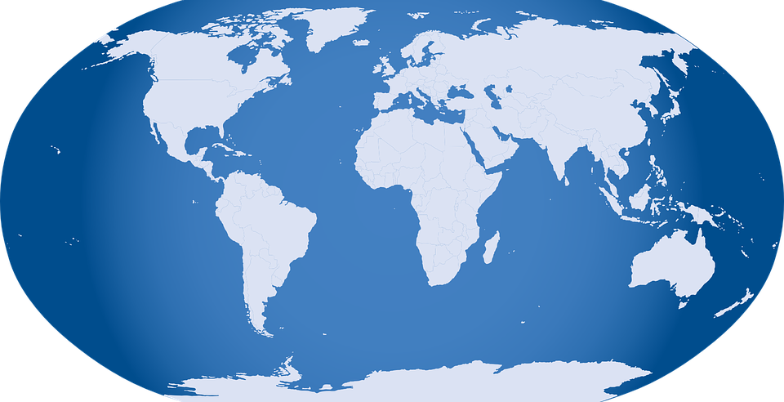
Maybe we should call our planet –
OCEAN!
Notes:
Image source: https://pixabay.com/p-32299/?no_redirect

Slide 9
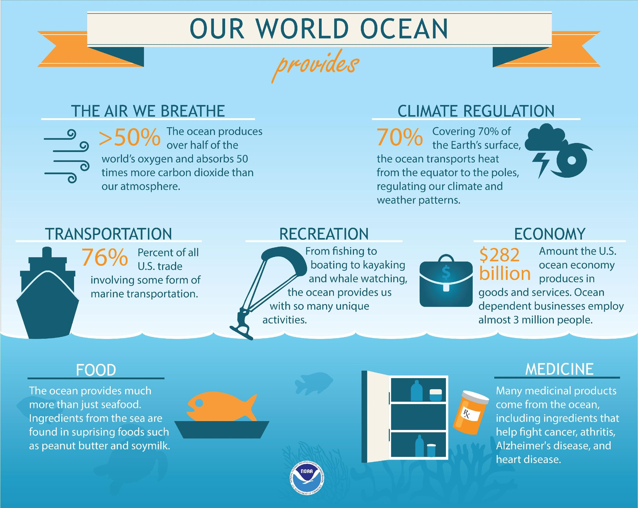

Slide 10
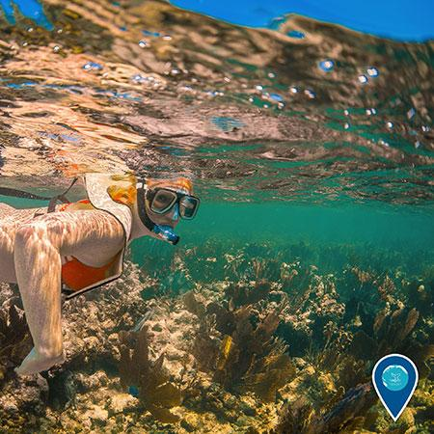
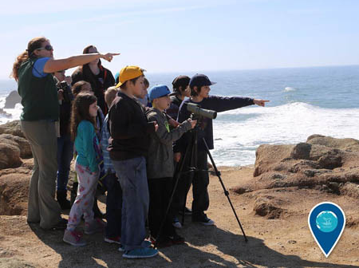
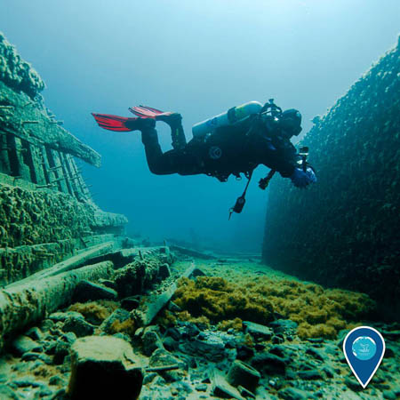
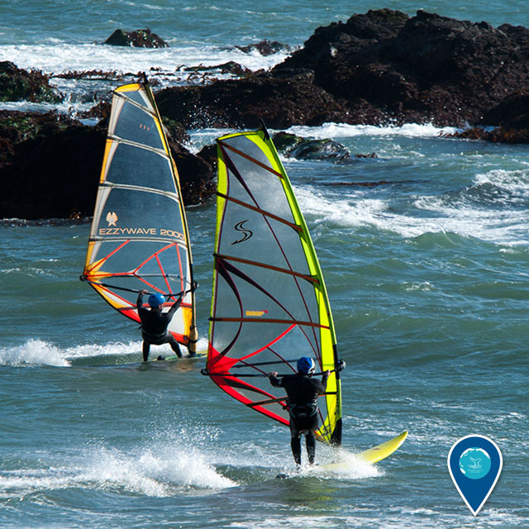
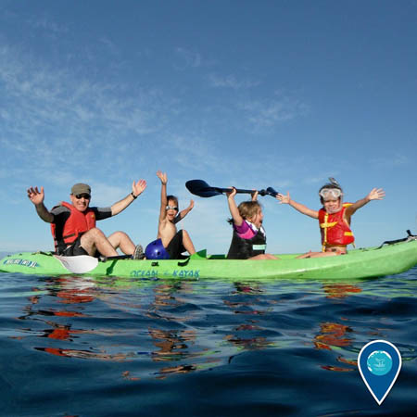
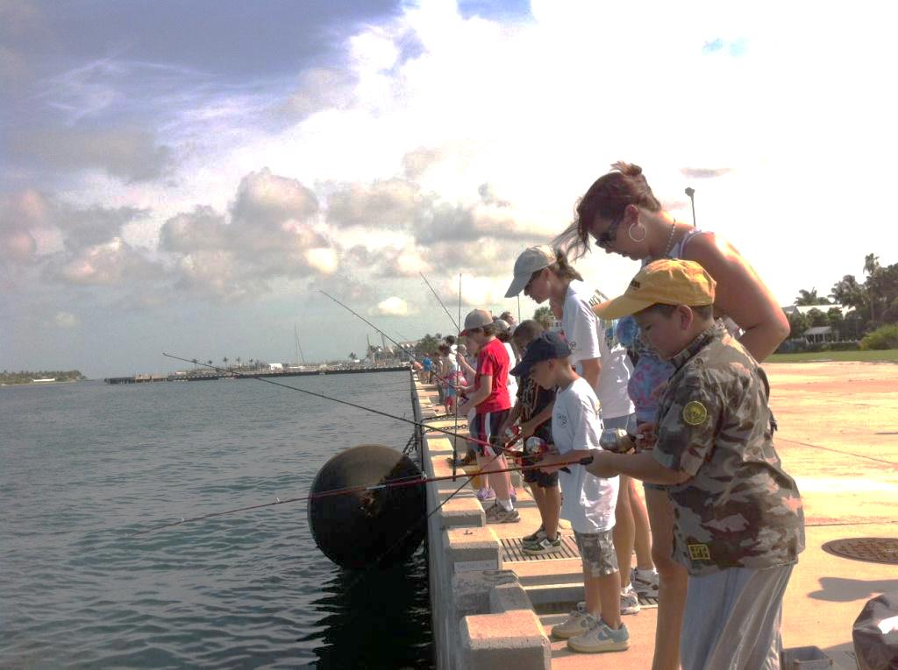
The ocean is a place to explore and enjoy!
Notes:
Image sources (from top left, clockwise):
Matt McIntosh/NOAA ; Jennifer Stock/NOAA; David J. Ruck/NOAA; Robert Schwemmer/NOAA; Claire Fackler/NOAA; NOAA

Slide 11
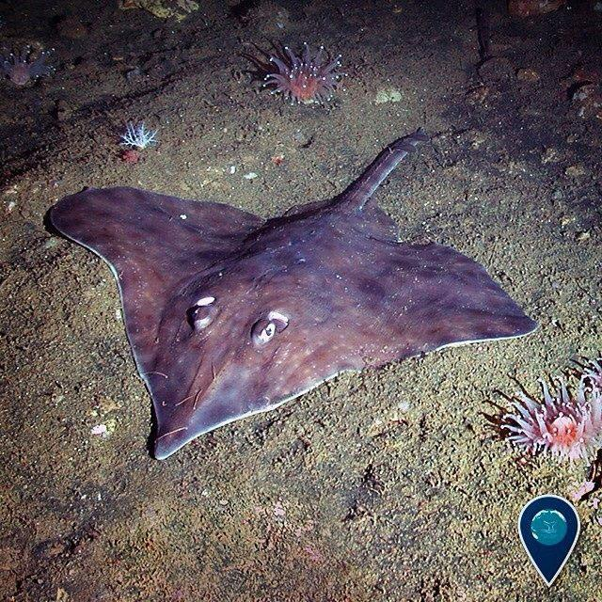
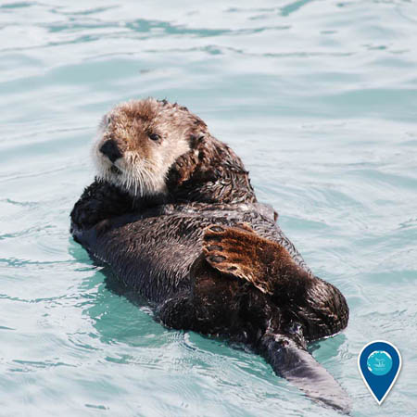
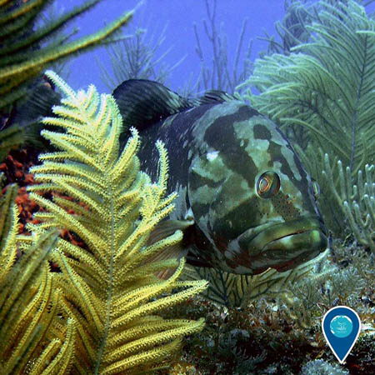
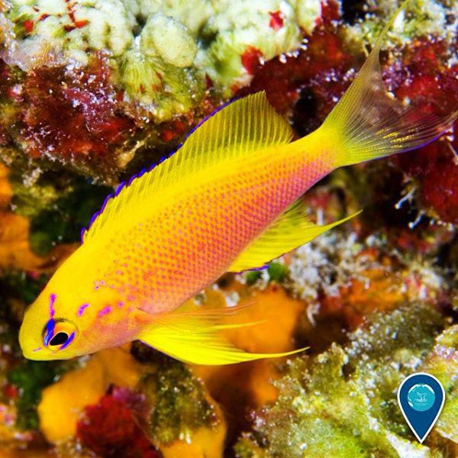
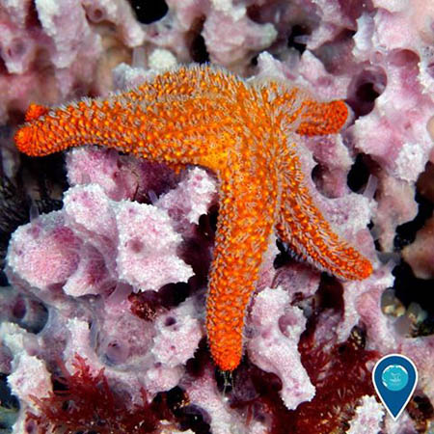
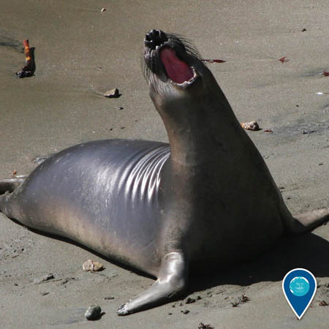
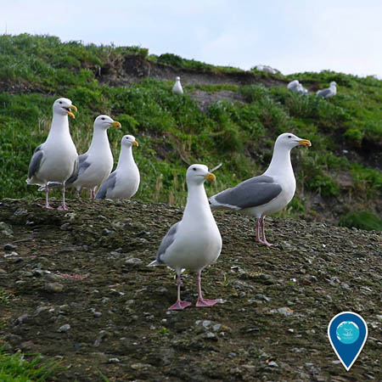
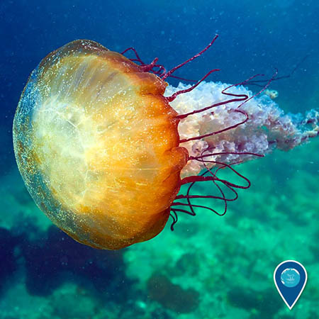
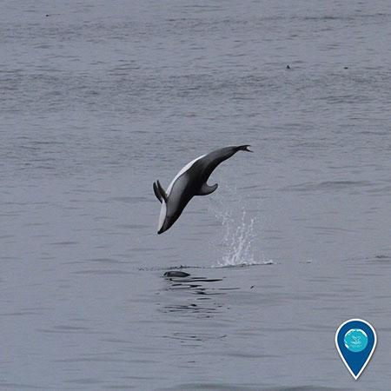
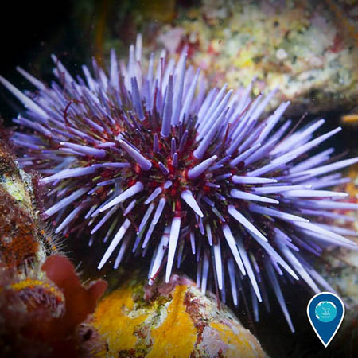
Long-nosed skate
Sea otter
Nassau grouper
Hawaiian longfin anthias
Sea star
Even though the ocean covers most of our planet, we know so very little about it. As a matter of fact, we know much more about land than the sea. We’ve only begun to get a glimpse of the many mysteries and stories that the ocean has to tell.
But we do know this…
Elephant seal
Sea nettle
Pacific white-sided dolphin
Glaucous-winged gulls
Purple sea urchin
Notes:
Image sources (from top left, clockwise):
Long-nosed skate: Cordell Bank NMS
Sea otter: NOAA
Nassau grouper: Alicia Farrer
Hawaiian longfin anthias: Greg McFall/NOAA
Elephant seal: NOAA
Purple sea urchin: Chad King/NOAA
Pacific white-sided dolphin: Sage Tezak/NOAA
Sea nettle: NOAA
Glaucous-winged gulls: Robert Steelquist/NOAA
Sea star: Greg McFall/NOAA

Slide 12
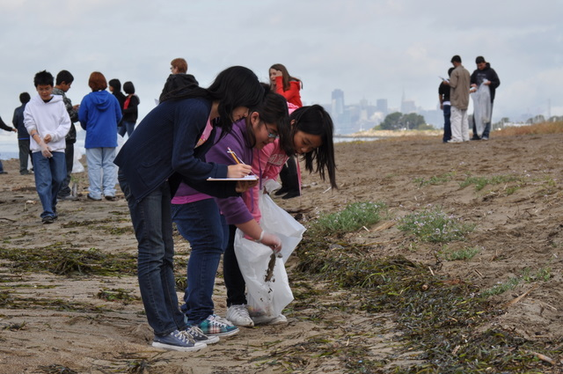
We have only ONE ocean and we have to take care of it!
Notes:
Image source: Nate Ivy

Slide 13
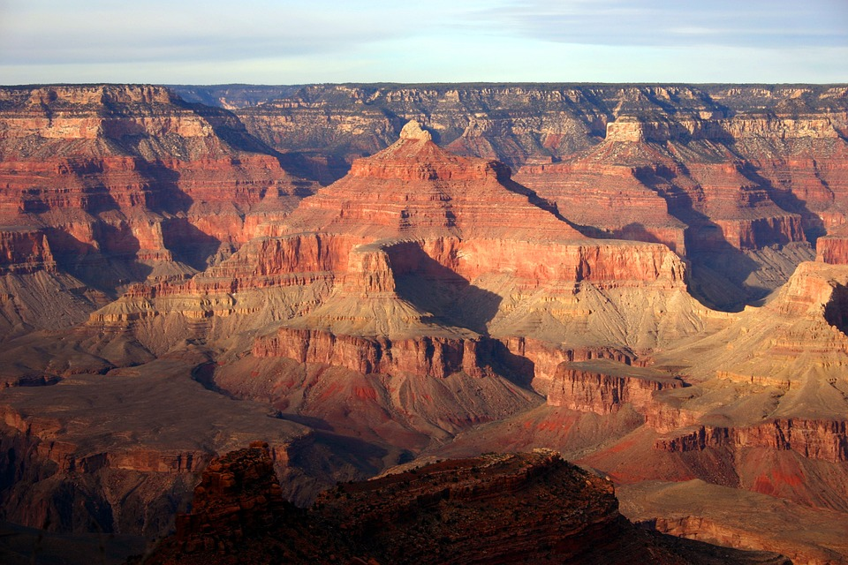
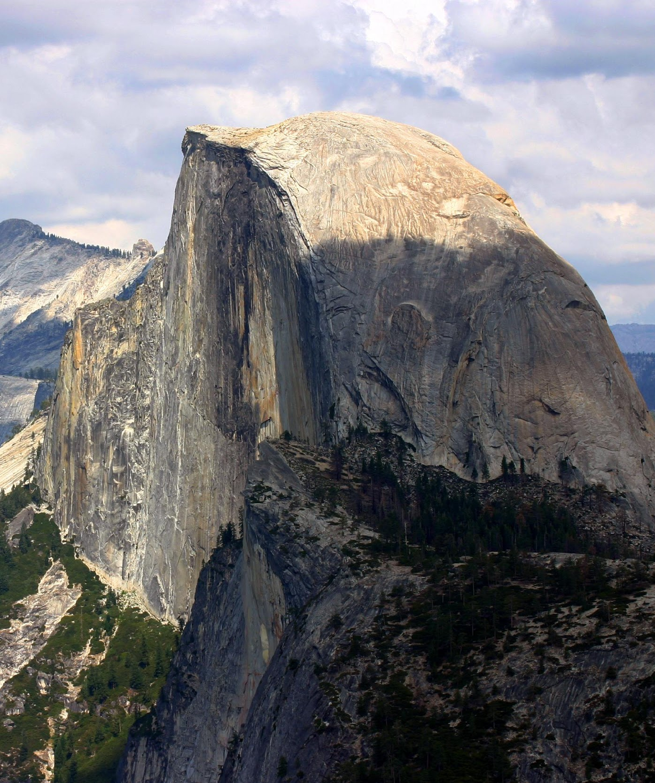
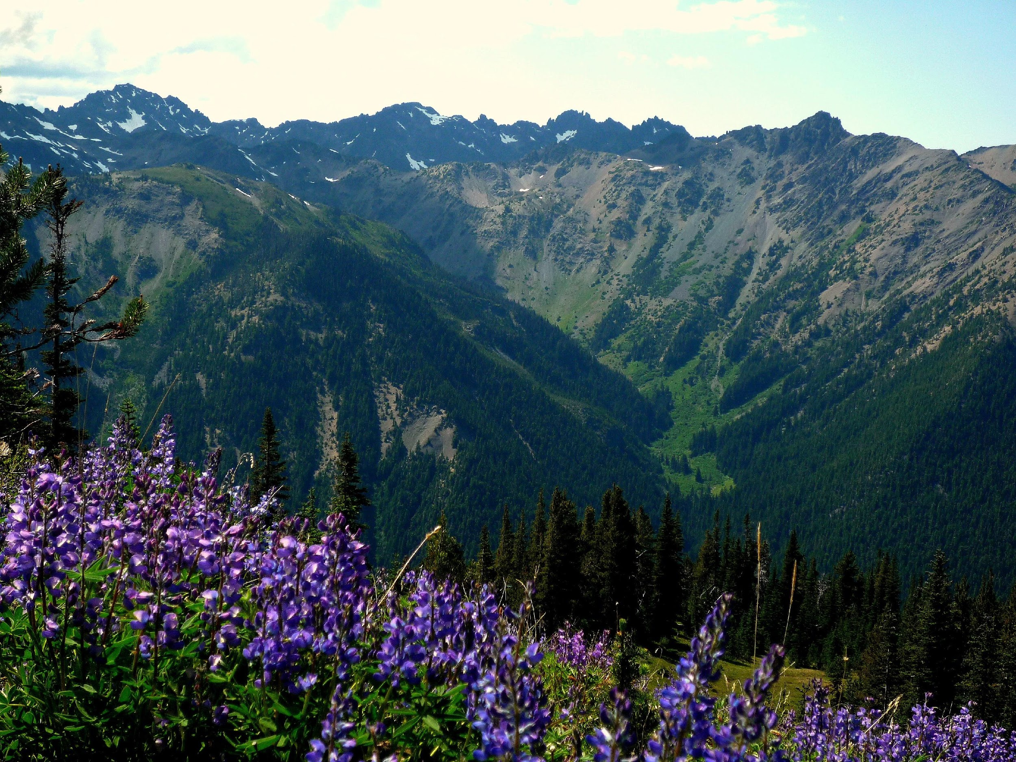
Our country’s national parks such as
Grand Canyon, Yosemite and Olympic protect large wilderness areas on LAND.
Notes:
Image sources (from top right, clockwise):
Grand Canyon: https://pixabay.com/p-911540/?no_redirect
Olympic: https://commons.wikimedia.org/wiki/File:Marmot_Pass,_Olympic_National_Park.jpg
Yosemite: https://commons.wikimedia.org/wiki/File:Half_dome_yosemite_national_park.jpg

Slide 14
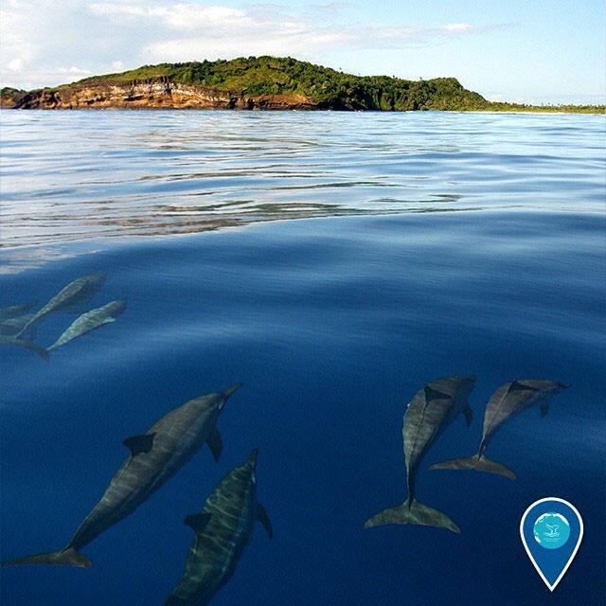
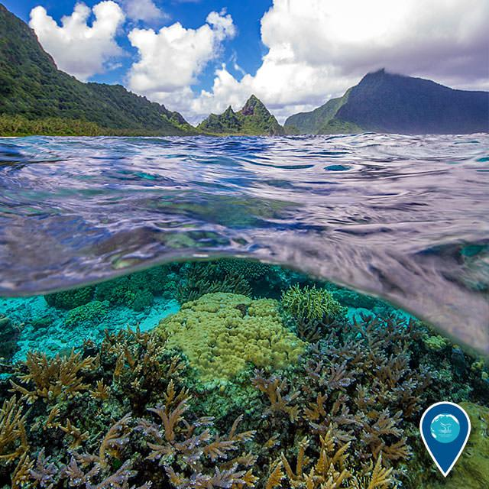
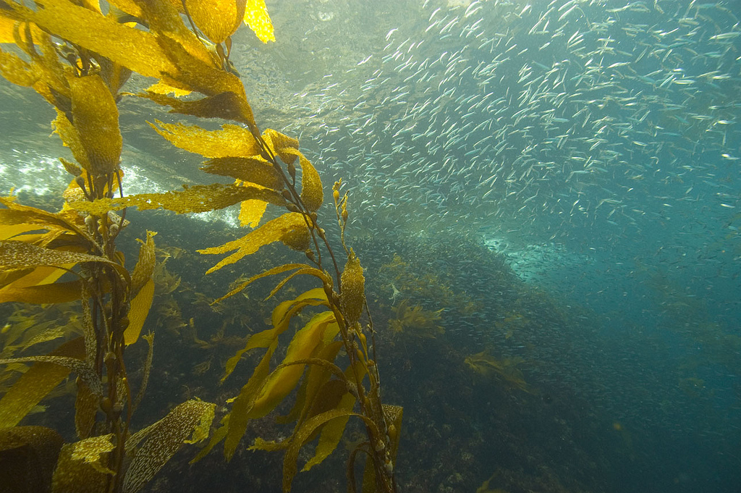
About 40 years ago, our government realized that we needed to also protect the wild areas UNDER the water, in our ocean and Great Lakes and along our coasts.
Notes:
Image sources (from top left, clockwise): Ed Lyman/NOAA; Matt McIntosh/NOAA; https://c1.staticflickr.com/3/2505/3859386800_80fd24290c_b.jpg

Slide 15
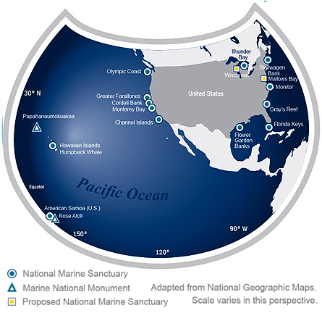
National Marine Sanctuaries
These underwater parks are called NATIONAL MARINE SANCTUARIES and they make up the National Marine Sanctuary System.
There are 13 national marine sanctuaries all over the United States including one in the Great Lakes (Lake Huron) called Thunder Bay National Marine Sanctuary.
There’s also an underwater national monument in the Hawaiian Islands called Papahānaumokuākea Marine National Monument.

Slide 16
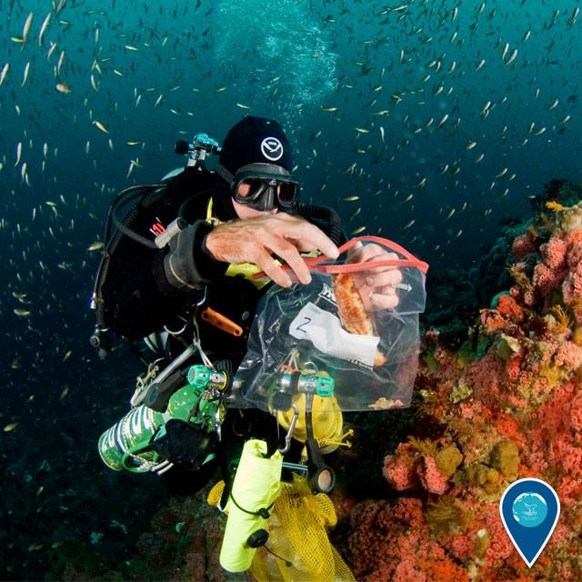
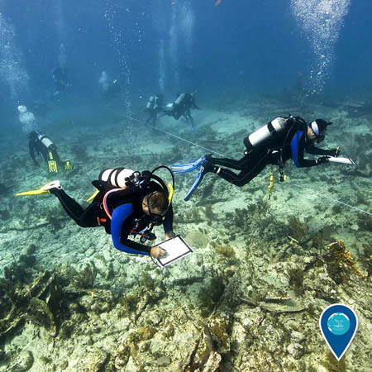
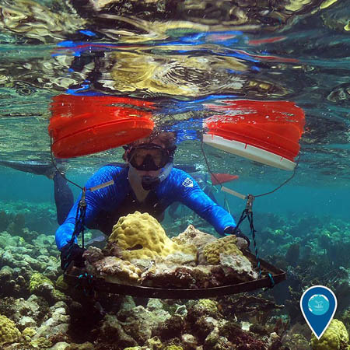
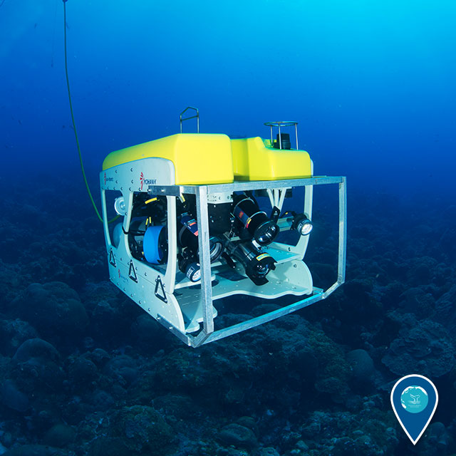
The National Marine Sanctuary System promotes
conservation, stewardship and ocean research.
Notes:
Image source (from top right, clockwise): Joe Hoyt/NOAA; Tane Casserley/NOAA; NOAA; NOAA

Slide 17
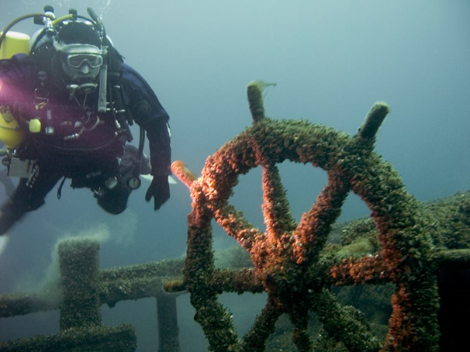
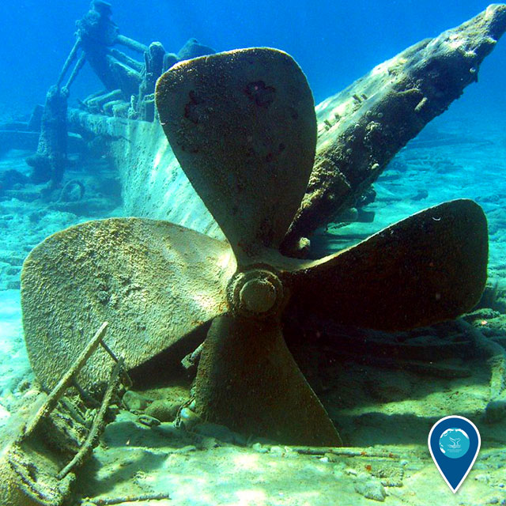
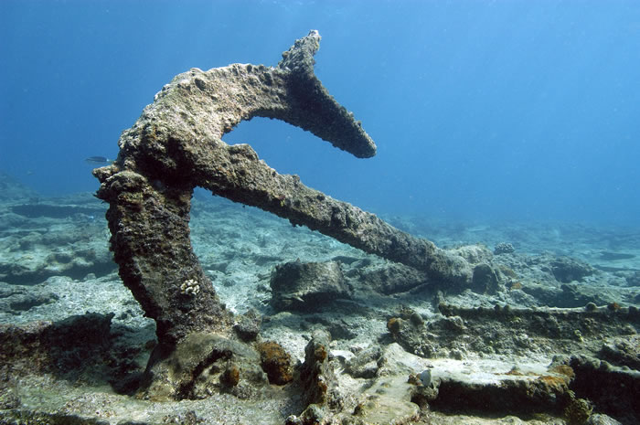
There are also shipwrecks and other cultural resources in many of the national marine sanctuaries which are kept safe in sanctuary waters where they can be studied over time.
Notes:
Image source(s): NOAA

Slide 18
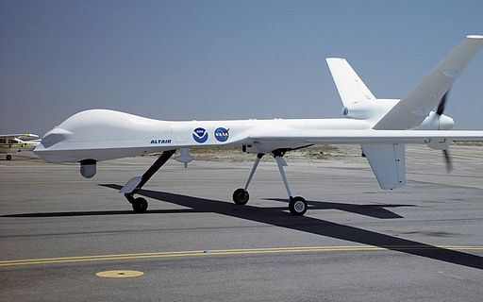
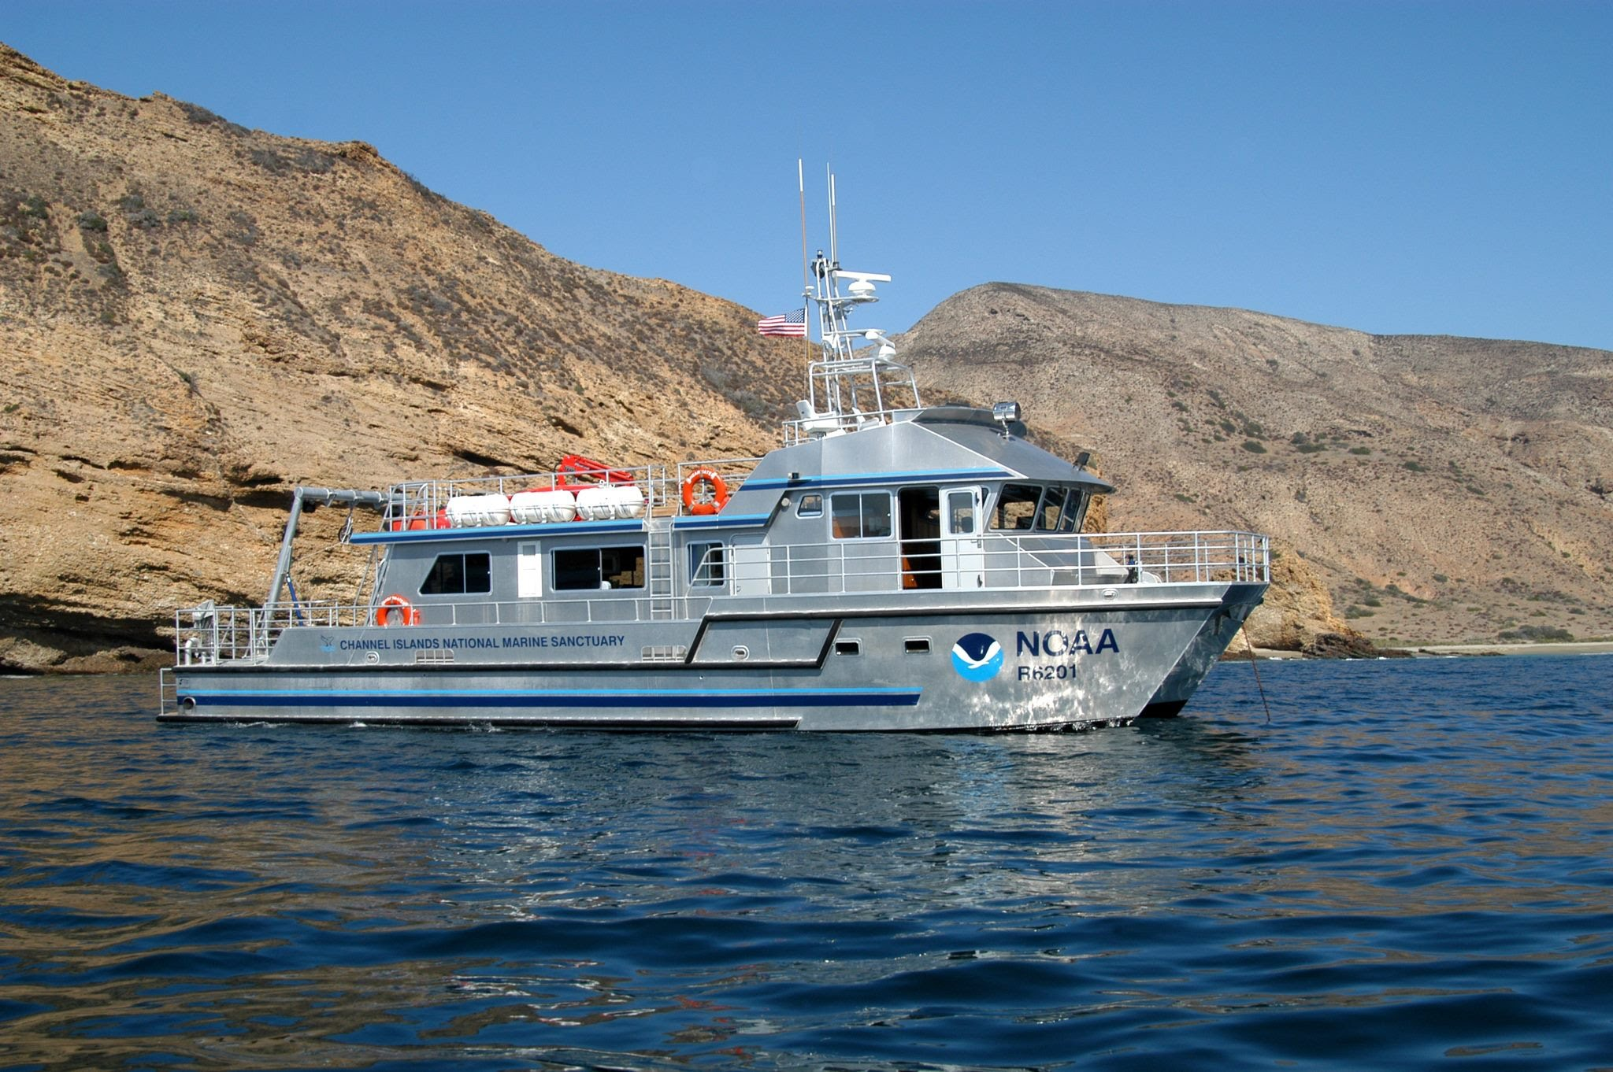
The National Marine Sanctuary System is overseen by a government agency called NOAA.
NOAA stands for the National Oceanic and Atmospheric Administration,
but everyone calls it NOAA (pronounced “Noah”).
The people who work for NOAA study our climate and weather as well as the ocean.
Notes:
Image source(s): NOAA

Slide 19
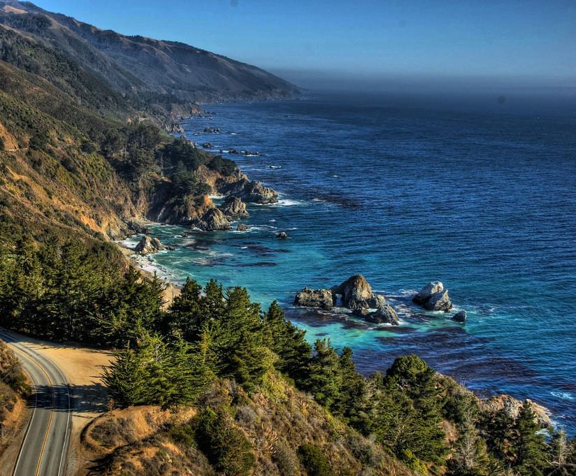
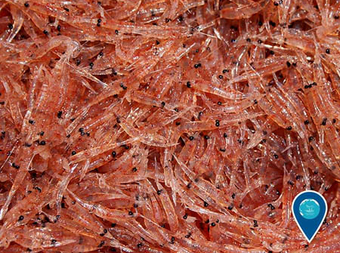
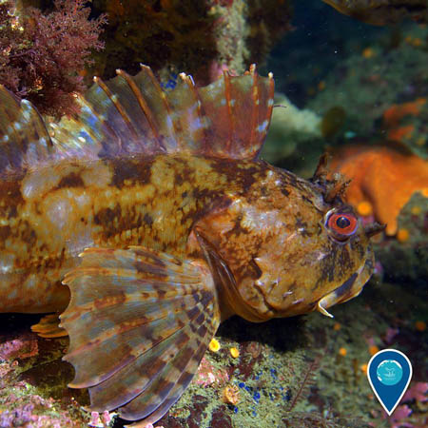
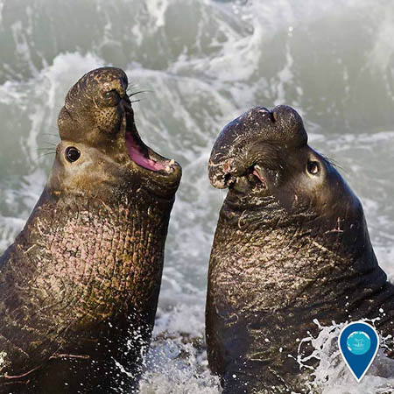
Take a look beneath the ocean’s surface…
Krill
Cabezon
Northern elephant seals
You will find magnificent organisms – small and large!
Notes:
Image sources (from left, clockwise):
Coastline: https://www.flickr.com/photos/joxur223/5019607320
Krill: Shannon Lyday/NOAA
Cabezon: Chad King/NOAA
Northern Elephant Seals: Mike Baird/NOAA

Slide 20
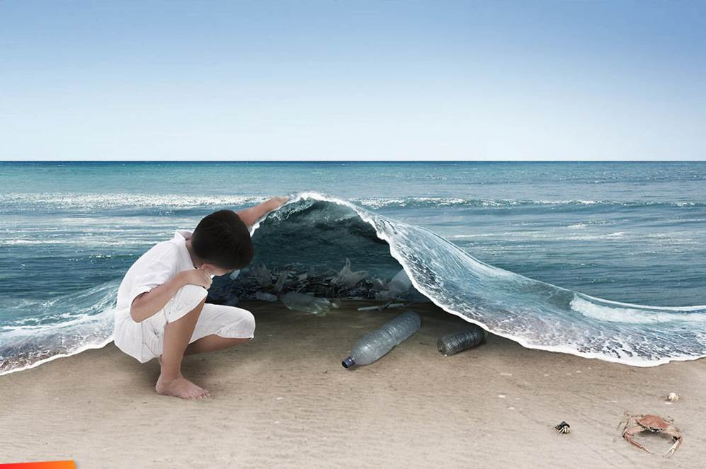
What else lies beneath the
ocean’s surface?
Notes:
Image source: “What Lies Under” – Ferdi Rizkiyanto 2011

Slide 21
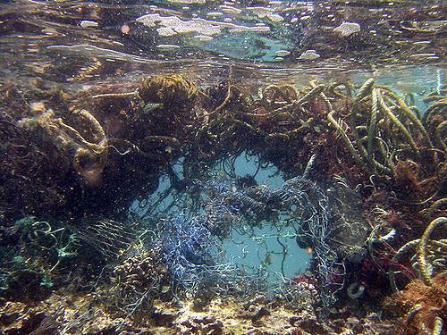
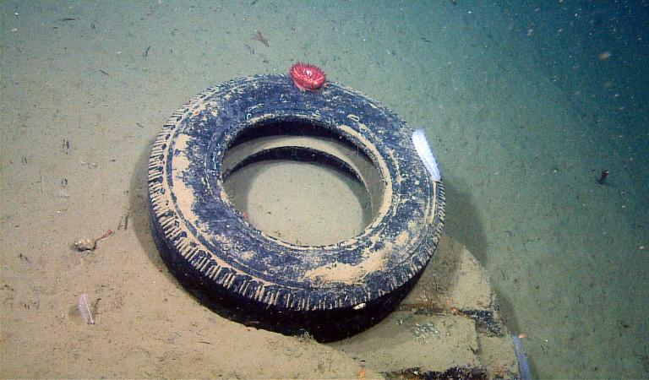
Marine Plastic Pollution – Global Scale
Marine Debris is a Global Environmental Issue
Trash can be found in all areas of the ocean, including…
Open Ocean
Deep Sea
Remote Islands
Coastal Areas
Notes:
Image sources (from top left, clockwise):
Open Ocean: https://www.flickr.com/photos/usoceangov/4314177438
Deep Sea:
http://news.nationalgeographic.com/content/dam/news/photos/000/682/68217.ngsversion.1422289469779.adapt.768.1.jpg
Coastal Areas: http://architizer.com/blog/help-fund-whim-architects-island-made-entirely-of-coastal-trash/media/454736/
Remote Islands: Image source: http://i.telegraph.co.uk/multimedia/archive/01391/plastic-kamilo_1391163c.jpg

Slide 22
Where does the trash come from?
An Introduction to Marine Litter
https://www.youtube.com/watch?v=DtfAhy2lgAA
Notes:
Video length: 2 minutes, 13 seconds

Slide 23
What are gyres?
Many believe that the “Pacific Garbage Patch” is a floating island of large plastic debris.
However, most of the debris found in this area are small pieces of floating plastic that are not noticeable to the naked eye.
Wind and wave action continuously mixes this debris in a whirlpool like motion, forming a gyre.
Learn more about the Great Pacific Garbage Patch: http://oceantoday.noaa.gov/trashtalk_garbagepatch/welcome.html
Notes:
Image source: http://staging.unep.org/docs/MarineLitter.pdf

Slide 24
What is the difference between a macroplastic and a microplastic?
What is a macroplastic?
What is a microplastic?
Large piece of plastic –
measuring greater than 5 mm in diameter
Small piece of plastic –
measuring less than 5 mm in diameter
Notes:
Image sources:
Macroplastic: https://upload.wikimedia.org/wikipedia/commons/a/a7/Plastic_pollution_083.jpg
Microplastic: http://cdn.phys.org/newman/gfx/news/hires/2013/microplastic.jpg

Slide 25
The Issue with large pieces of plastic: Plastic Entanglement
Marine animals often get tangled up in macroplastic litter – making it difficult for them to move or eat. Plastic entanglement can be deadly.
Notes:
Image sources (from top left, clockwise):
http://theamericanenergynews.com/wp-content/uploads/2016/01/capodogliocoda252bsub-albertodarioromeo.jpg;
https://www.emaze.com/@AFLWQQT/Plastic
https://s-media-cache-ak0.pinimg.com/564x/29/89/18/298918b975d5243fbe3307590271168a.jpg
http://plasticsbiology.weebly.com/uploads/4/7/7/9/47792045/6819470_orig.jpg
http://www.b-e-a-c-h.org/marine_debris.html

Slide 26
Plastic Ingestion
Animals often mistake plastic litter for their natural food source – such as jellies, small fish, or krill. Organisms as small as plankton have been known to ingest plastic litter.
Once in their stomachs, plastic pieces can build up and cause blockages – making it hard for the animal to digest its food.
Notes:
NOTE: Glowing green within that small plankton are tiny pieces of microplastics!
Image sources (from top left, clockwise):
http://ichef.bbci.co.uk/news/1024/cpsprodpb/FF37/production/_85853356_plasticshukmanplankton2.jpg
www.chrisjordan.com
http://bioplasticintheocean.weebly.com/uploads/2/6/0/2/26021694/5974089_orig.jpg

Slide 27
How can plastic ingestion harm humans? Toxins, from plastic factory to fork
Plastic products are often made using harmful toxins
Once in the ocean, plastic particles can absorb more toxins from the surrounding environment
Scientists are currently studying if and how these toxins may be harmful to human health.
When fish ingest plastic particles, the toxins in the plastic are absorbed by their fatty tissues
These fatty tissues are what humans eat when we consume fish
Image sources: http://www.clipartkid.com/images/557/chemical-reaction-clipart-clipart-panda-free-clipart-images-h6RArx-clipart.png
http://clipartix.com/wp-content/uploads/2016/05/Waves-sea-wave-clipart.png
http://files.focusky.com.cn/web/demo/economic-theories/files/extfiles/ext_02015514163119737.png
http://pngimg.com/upload/fork_PNG3067.png
http://www.mes-conference.ru/images/awards/questionMark.gif
Notes:
Image source: http://ww2.kqed.org/quest/wp-content/uploads/sites/39/2013/05/Rainbow-Runner_M-Eriksen.jpg

Slide 28
Journey to microplastics
How do big plastic pieces break down?
When plastic litter interacts with waves and sunlight it breaks down into tiny little pieces.
Notes:
Image sources (from left to right):
http://www.clipartkid.com/images/198/americanos-ZM7CCC-clipart.png
http://clipartix.com/wp-content/uploads/2016/05/Sea-waves-clipart.png
http://clipartix.com/wp-content/uploads/2016/04/Sunshine-sun-clipart-free-clipart-images-2.png
https://static.independent.co.uk/s3fs-public/thumbnails/image/2014/07/12/20/14microbeads.jpg

Slide 29
Plastic Microbeads
Have you seen these?
Plastic microbeads are found in many cosmetic products such as face wash and toothpaste.
These tiny little beads are designed to wash down the drain, but where do they go after that?
A Victory for the Ocean:
The Federal Microbead-Free Waters Act of 2015 has banned the sale of products containing microbeads starting in July 2017!
https://www.youtube.com/watch?v=uAiIGd_JqZc
Notes:
Video length: 4 minutes, 35 seconds
Image sources:
5 Gyres
https://assets.rbl.ms/6474152/980x.jpg

Slide 30
Microfiber Pollution
Microbeads are not the only tiny pollutants found in marine environments.
Tiny plastic fibers that shed from our synthetic clothes in the washing machine are now being found in waterways and the ocean. What happens once they reach the ocean?
The Story of Stuff:
http://storyofstuff.org/movies/story-of-microfibers/
Notes:
Video length: 2 minutes, 47 seconds
Images’ source: The Story of Stuff

Slide 31
What can
YOU
do?
Notes:
Image source: https://pixabay.com/p-1750942/?no_redirect

Slide 32
Reduce Waste at Your School
Step up your recycling and composting efforts
Replace single-use condiment packets with bulk dispensers
Replace spork packs with bulk utensil dispensers
Refuse plastic straws or use paper straws instead
Power down all electronic devices when not in use
Notes:
Image sources (from top right, clockwise):
http://www.webstaurantstore.com/images/products/main/7456/24188/carlisle-38504-condiment-dispenser-rail-with-4-standard-pumps.jpg
https://static.grainger.com/rp/s/is/image/Grainger/6ZCP8_AS01?$mdmain$
http://www.blakescakeandcandy.com/home.php?cat=610

Slide 33
Start in your cafeteria:
Encourage students to take only what they need
Place recycling bins in areas where trash is often found
Create a share bin: where students can leave items that they did not eat for others to take
Notes:
Image source: USDA

Slide 34
Make Art NOT Trash!
Bottle Cap Mural at Carmel River School – Carmel, CA
Art projects are a great way to spread the message about going green, and thinking blue! Use trash found on your campus to create a captivating mural.

Slide 35
Reduce Waste in Your Community
Ways to keep your community clean:
Participate in a beach, river, or park clean-up
Reach out to local restaurants to encourage them to reduce their waste
Straws are a great place to start – encourage local restaurants to serve straws only upon request
Write to your local government officials to inspire them to take action
Spread the word about zero waste to your friends and family members
Remember: change in your community starts with YOU.
Set an example for your peers by keeping your community free of debris!
Notes:
Image sources (from top to bottom):
http://yovenice.com/wp-content/uploads/2015/07/Beach-Clean-Up-July-5th.png
http://www.baycrossings.com/admin/HTML/upload/download/1856c_chiu_talking_at_rally.jpg
NOAA Marine Debris

Slide 36
Reduce Waste at Home
You and your family members can take similar steps to reducing waste in your home by: using less plastic products, repurposing items before throwing them away, recycling, and choosing to use reusable items…
Notes:
Image source: http://www.clipartfinders.com/clipart/67/good-neighbor-policy-ndash-the-san-diego-real-estate-dad-perspective--67391.gif

Slide 37
Refuse Single-use Plastics
Notes:
Image sources (from top left, clockwise):
Cup: http://clubamenities.com/10-oz-dixie-clear-plastic-cup/
Bag: http://cen.acs.org/content/dam/cen/92/37/09237-cover-plasticbag.jpg
Utensils: http://cen.acs.org/content/dam/cen/92/37/09237-cover-plasticbag.jpg
Bottle: https://www.packari.com/out/pictures/master/product/1/902104_S00020.jpg
Syrofoam package: https://recycle2011.files.wordpress.com/2011/04/styrofoam2.jpg
Straws: http://www.heraldplastic.com/media/wysiwyg/0271DISP.jpg

Slide 38
Choose Reusable Items!
Notes:
Image sources (from top left, clockwise):
Bottle: www.turbosquid.com/3d-models/3d-reusable-aluminium-water-bottle/816913
Wooden utensils: http://mightynest.com/sites/mightynest.com/files/imagecache/product_preview/to-go-ware-utensils.jpg
Straws: http://gogreentravelgreen.com/best-reusable-drinking-straws-kids/
Lunch box: http://assets.inhabitots.com/wp-content/uploads/2010/11/PLANETBOX-with-food-and-dippers.jpg
Bag: http://www.apparelnbags.com/ultraclub/r3000-reusable-shopping-bag.htm

Slide 39
YOU have the power to make a change…
https://www.ted.com/talks/melati_and_isabel_wijsen_our_campaign_to_ban_plastic_bags_in_bali?language=en
Melati and Isabel Wijsen are teenage activists that launched the campaign “Bye Bye Plastic Bags.”
YOU can be the change too!
Notes:
Video length: 11 minutes
Image source: https://www.ted.com/talks/melati_and_isabel_wijsen_our_campaign_to_ban_plastic_bags_in_bali

Slide 40
What will YOU do to protect the ocean & the organisms that depend on it?
Notes:
Photo sources (from top left, clockwise): NOAA/NMSF; Peter Flood; Chad King/NOAA; Claire Fackler/NOAA; Dan Clark/USFWS; Stuart Halewood; Douglas Croft/MarineLifeStudies.org, under NOAA permit #20519

