Slide 1
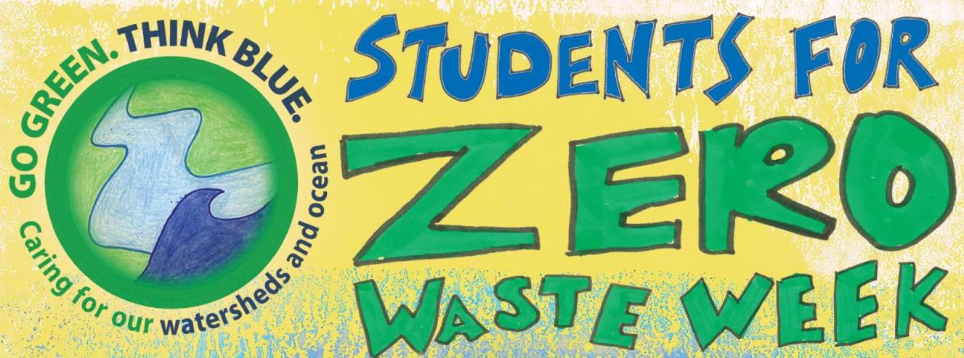
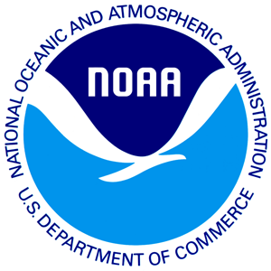

Slide 2
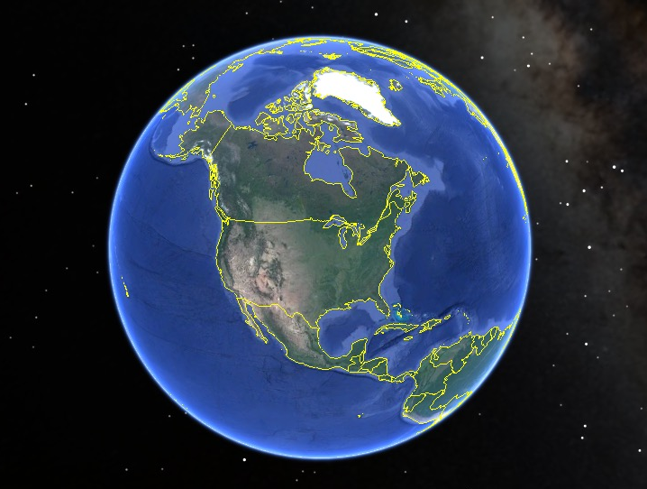
Planet Earth
Historically there are 5 named oceans

Slide 3
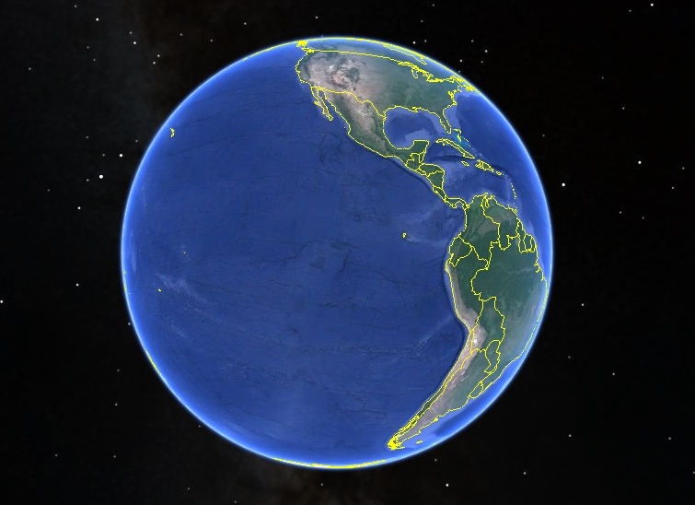
Pacific Ocean
…but these 5 oceans are not separate bodies of water.

Slide 4
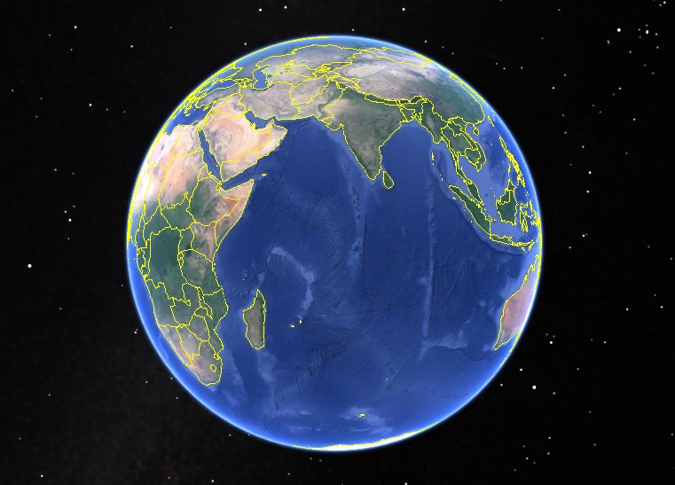
Indian Ocean
These 5 oceans form one continuous ocean mass.

Slide 5
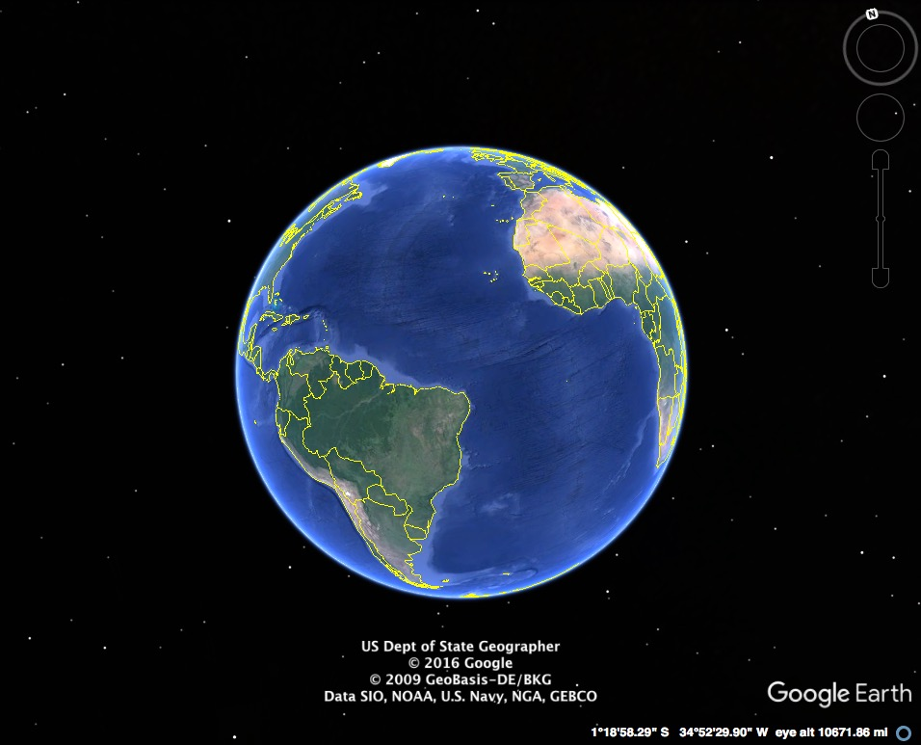
They are each part of one global ocean system.
Atlantic Ocean

Slide 6
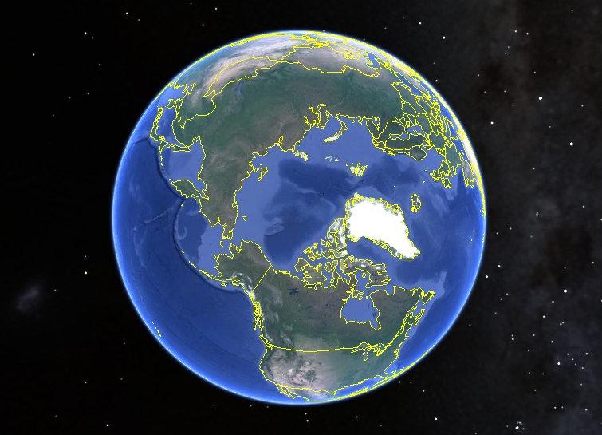
Arctic Ocean
This vast body of water covers 71% of our planet.

Slide 7
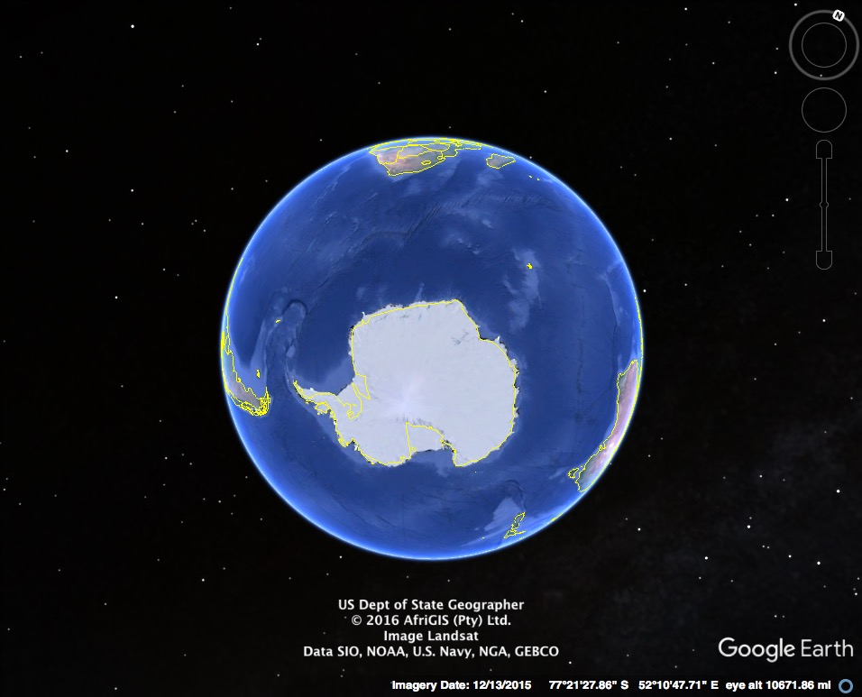
Question: Why do we call our planet “Earth” when most of the planet is covered in water?
Southern Ocean

Slide 8
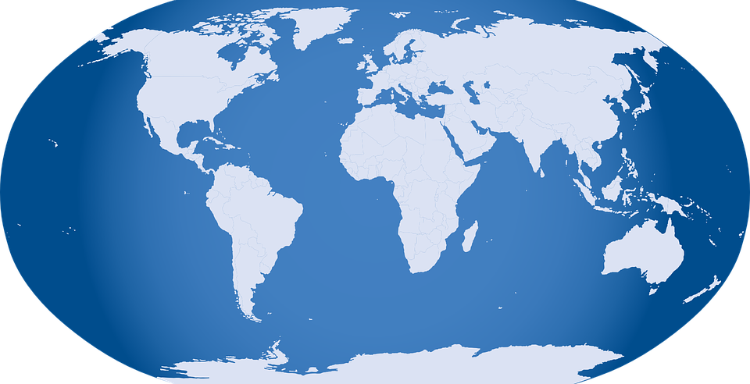
Maybe we should call our planet –
OCEAN!
Image source: https://pixabay.com/p-32299/?no_redirect

Slide 9
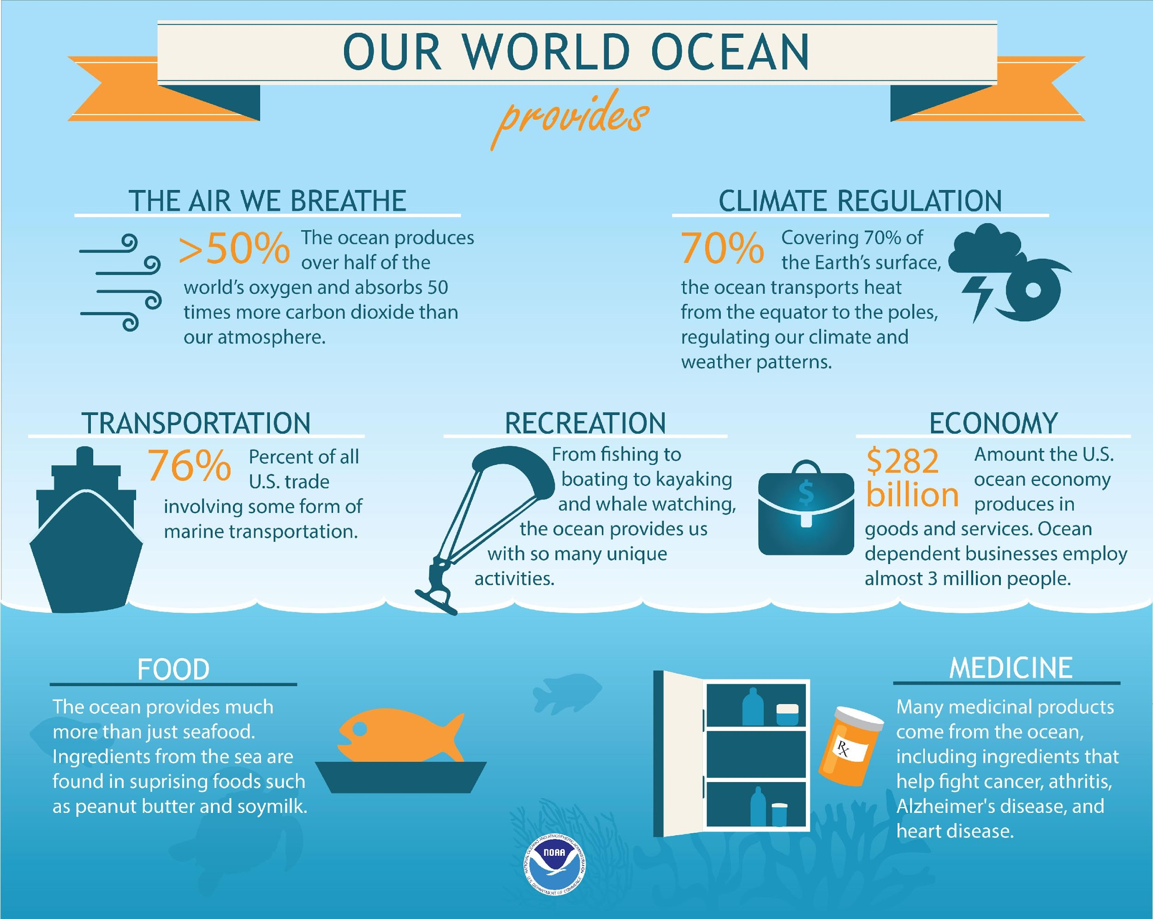

Slide 10
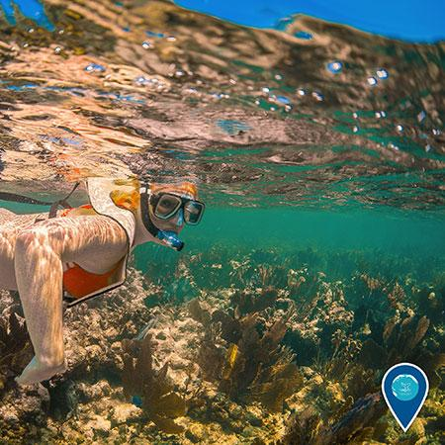
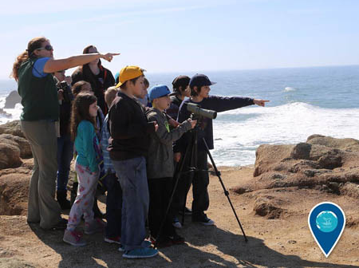
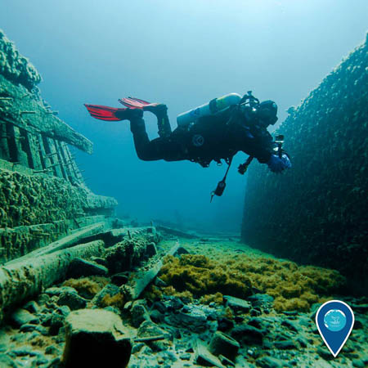
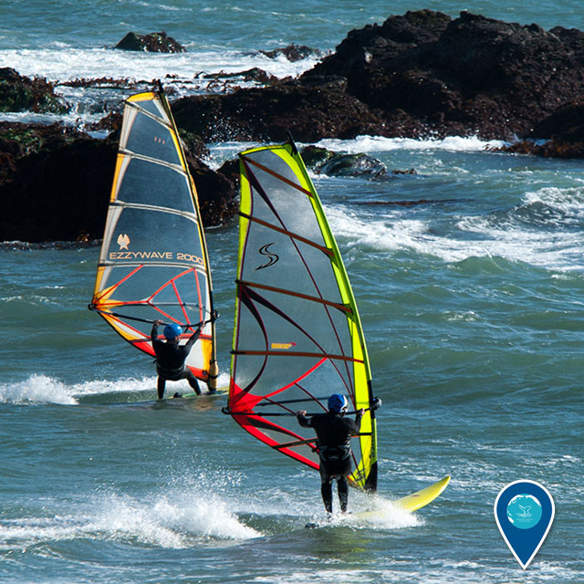
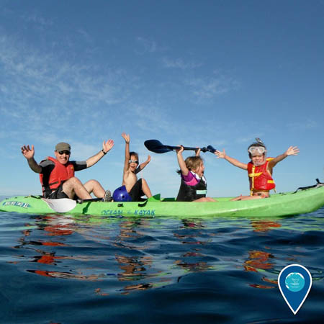
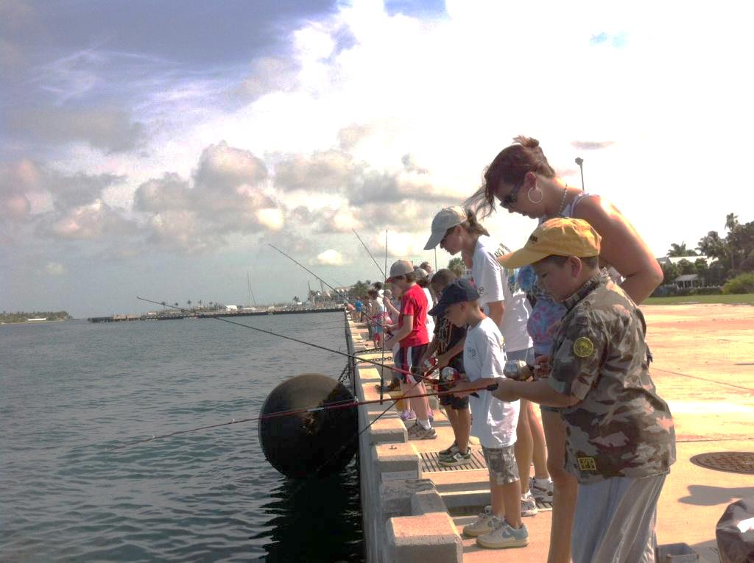
The ocean is a place to explore and enjoy!
Image source: Matt McIntosh/NOAA
Image source: Jennifer Stock/NOAA
Image source: David J. Ruck/NOAA
Image source: Photo: Claire Fackler/NOAA
Image source: Robert Schwemmer/NOAA)
Image source: NOAA

Slide 11
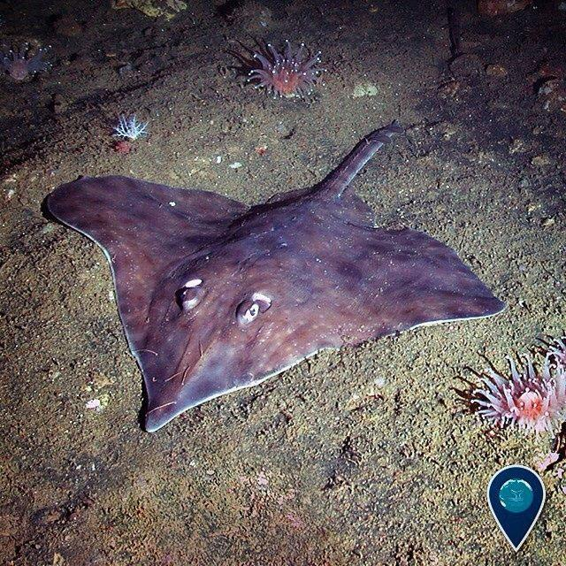
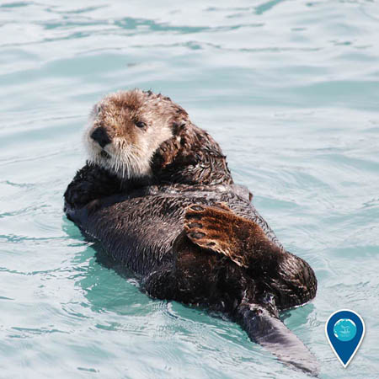
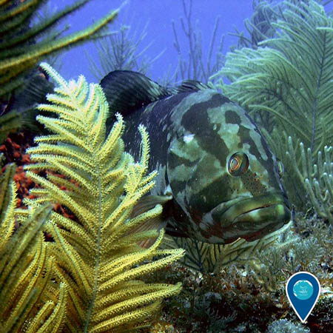
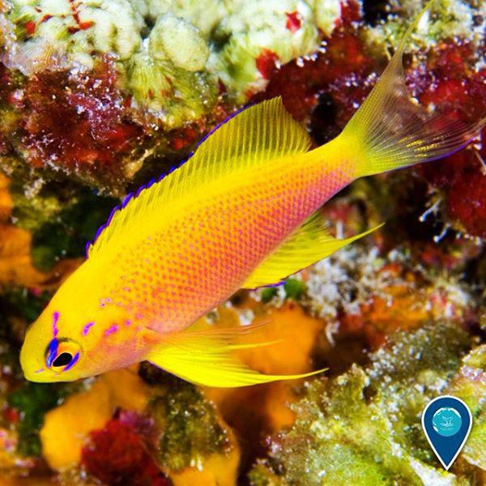
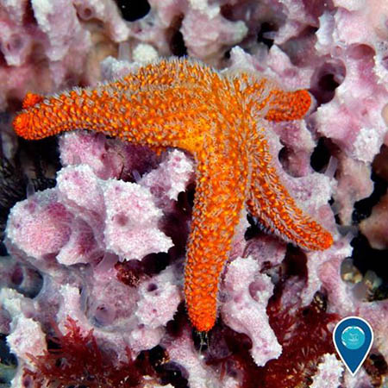
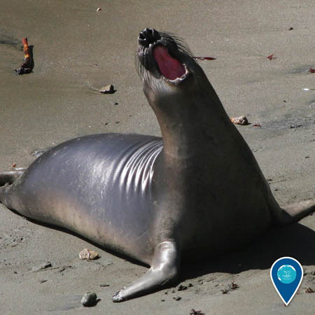
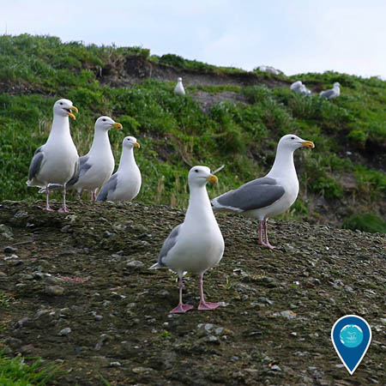
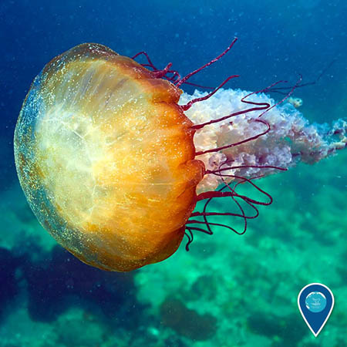
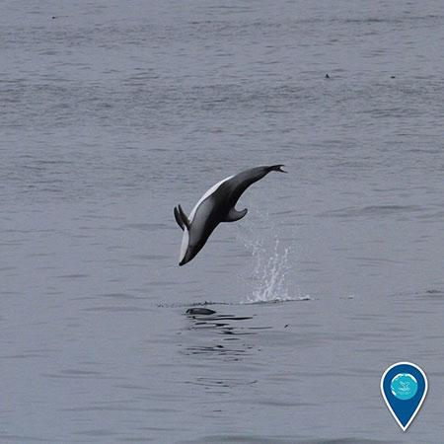
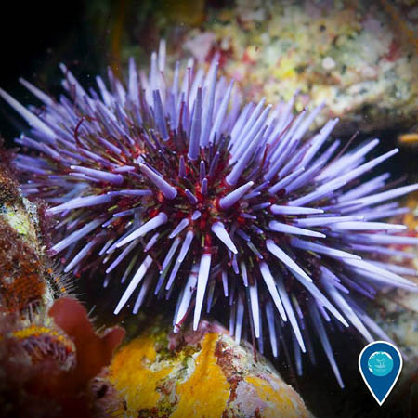
Long-nosed skate
Sea otter
Nassau grouper
Hawaiian longfin anthias
Image source: Greg McFall/NOAA
Image source: Cordell Bank NMS
Image source: NOAA
Image source: Alicia Farrer
Sea star
Even though the ocean covers most of our planet, we know so very little about it. As a matter of fact, we know much more about land than the sea. We’ve only begun to get a glimpse of the many mysteries and stories that the ocean has to tell.
But we do know this…
Image source: NOAA
Elephant seal
Image source: Greg McFall/NOAA
Sea nettle
Pacific white-sided dolphin
Image source: Chad King/NOAA
Image source: Robert Steelquist/NOAA
Glaucous-winged gulls
Purple sea urchin
Image source: NOAA
Image source: Sage Tezak/NOAA

Slide 12
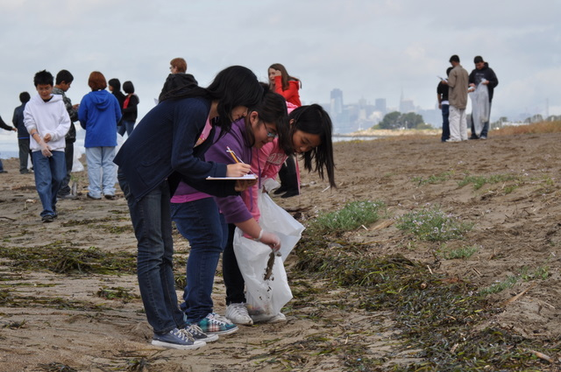
We have only ONE ocean and we have to take care of it!
Image source: Nate Ivy

Slide 13
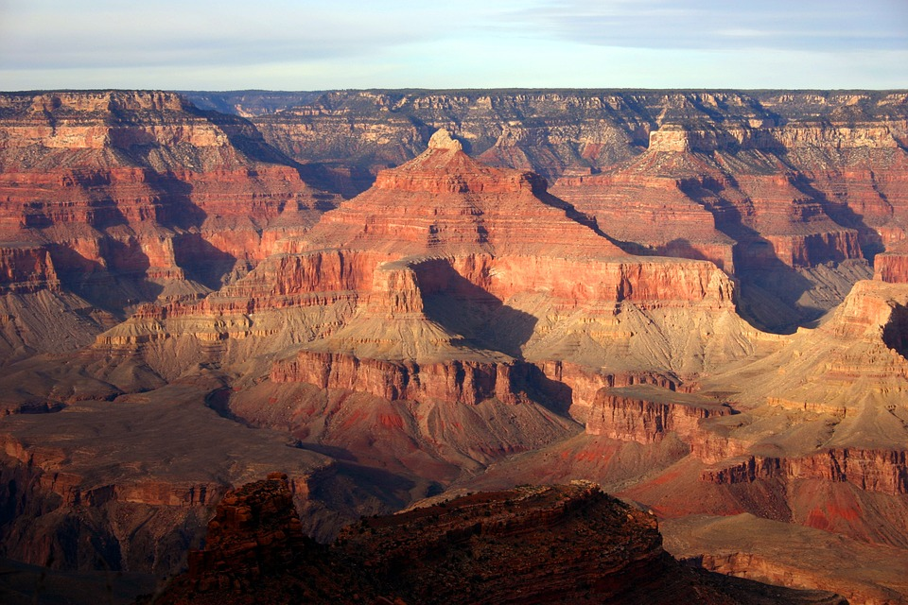
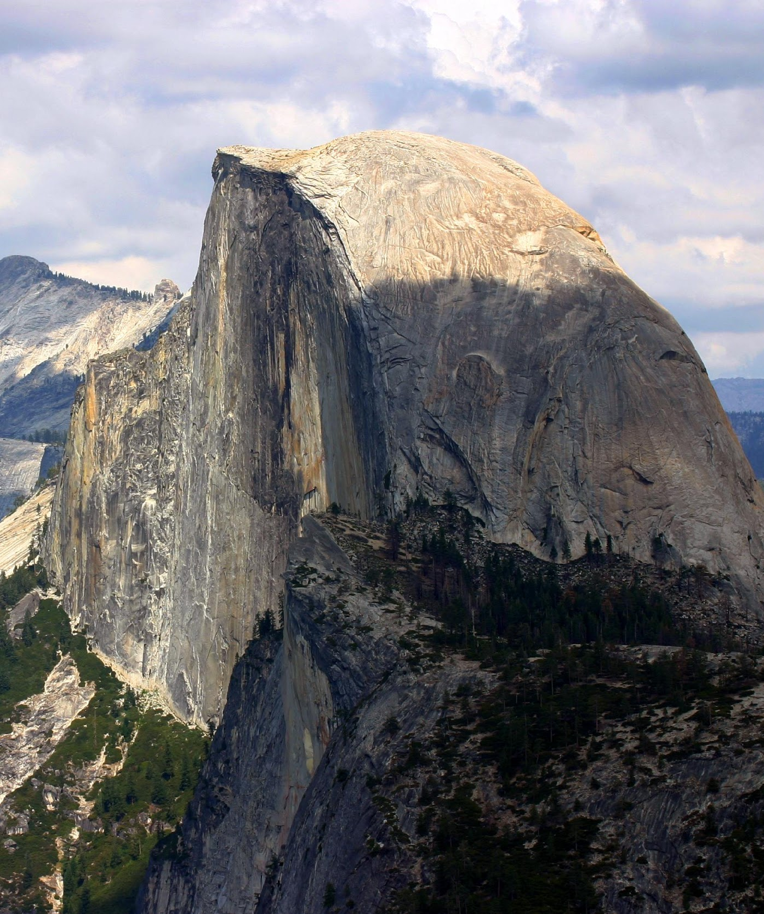
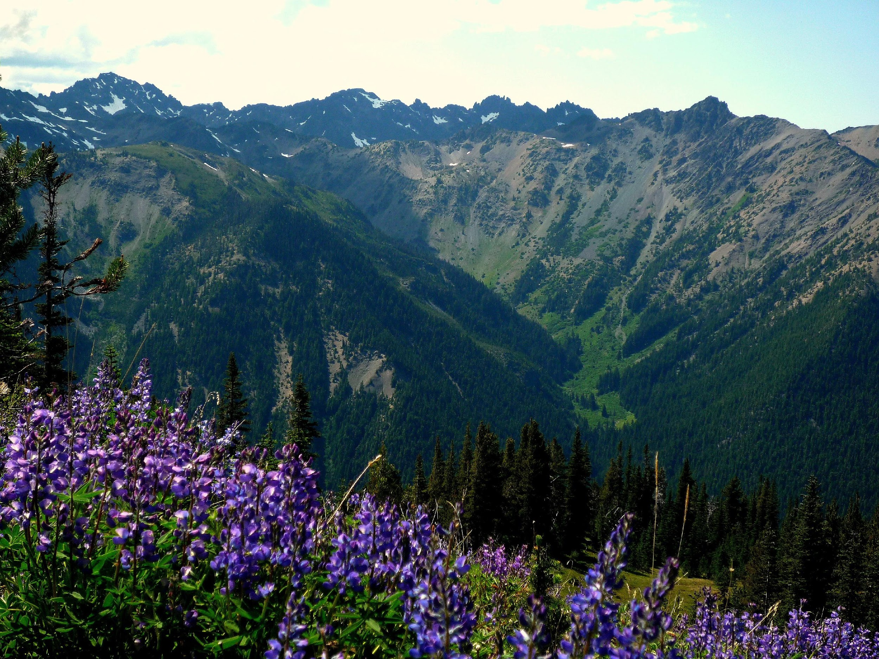
Our country’s national parks such as
Grand Canyon, Yosemite and Olympic protect large wilderness areas on LAND.
Image source: https://pixabay.com/p-911540/?no_redirect
Image source: https://commons.wikimedia.org/wiki/File:Half_dome_yosemite_national_park.jpg
Image source: https://commons.wikimedia.org/wiki/File:Marmot_Pass,_Olympic_National_Park.jpg

Slide 14
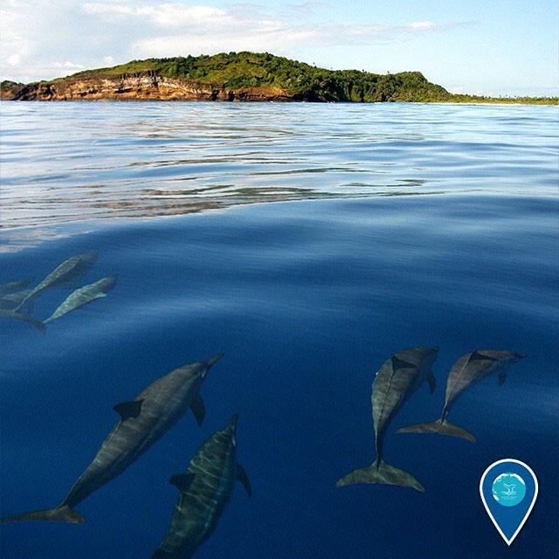
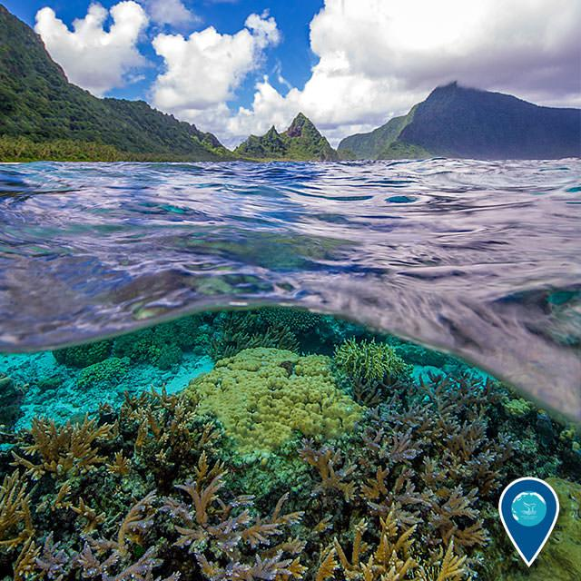
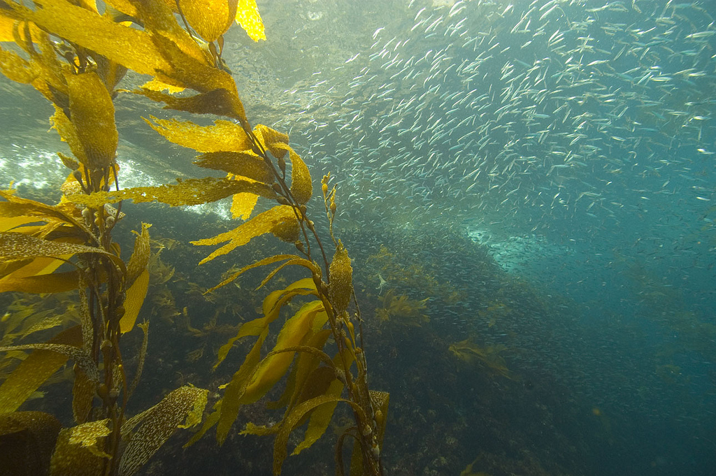
About 40 years ago, our government realized that we needed to also protect the wild areas UNDER the water, in our ocean and Great Lakes and along our coasts.
Image source: Ed Lyman/NOAA
Image source: https://c1.staticflickr.com/3/2505/3859386800_80fd24290c_b.jpg
Image source: Matt McIntosh/NOAA

Slide 15
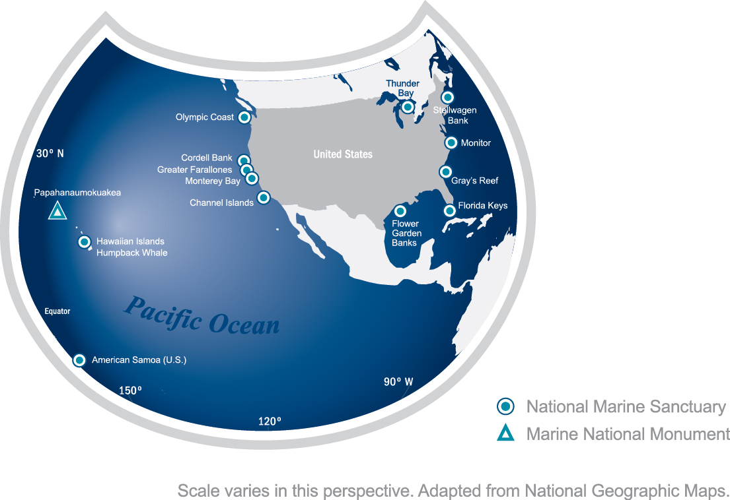
National Marine Sanctuaries
These underwater parks are called NATIONAL MARINE SANCTUARIES and they make up the National Marine Sanctuary System.
There are 13 national marine sanctuaries all over the United States including one in the Great Lakes (Lake Huron) called Thunder Bay National Marine Sanctuary.
There’s also an underwater national monument in the Hawaiian Islands called Papahānaumokuākea Marine National Monument.

Slide 16
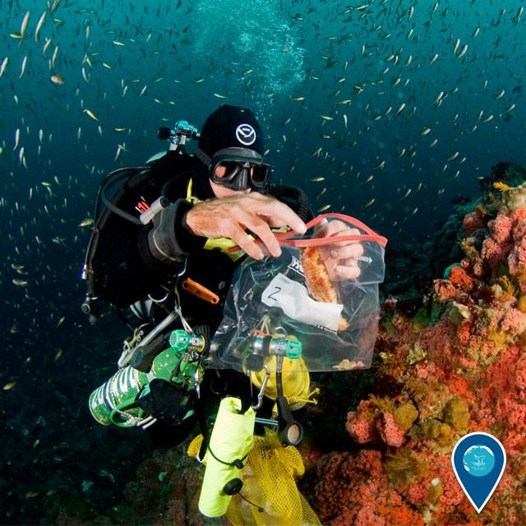
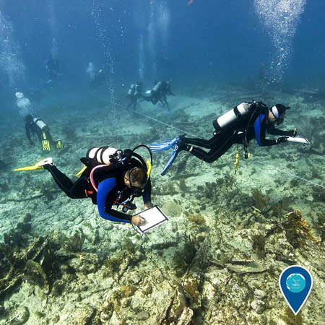
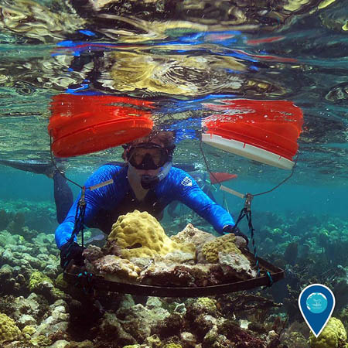
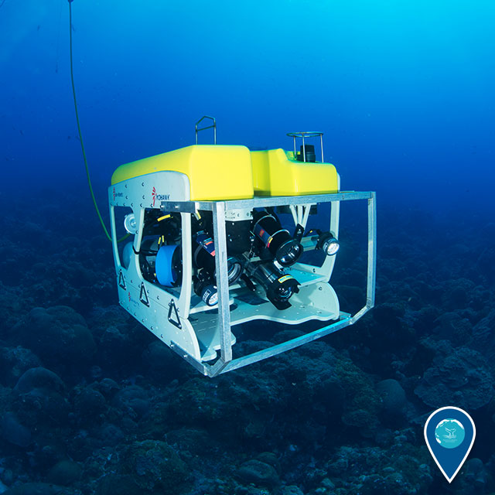
Image source: Joe Hoyt/NOAA
The National Marine Sanctuary System promotes
environmental protection, stewardship and ocean research.
Image source: Tane Casserley/NOAA
Image source: NOAA
Image source: NOAA

Slide 17
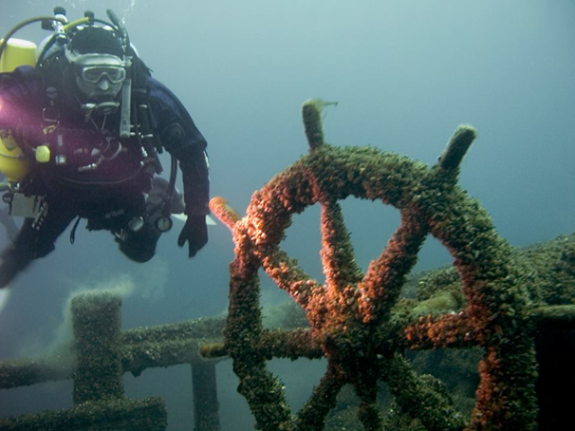
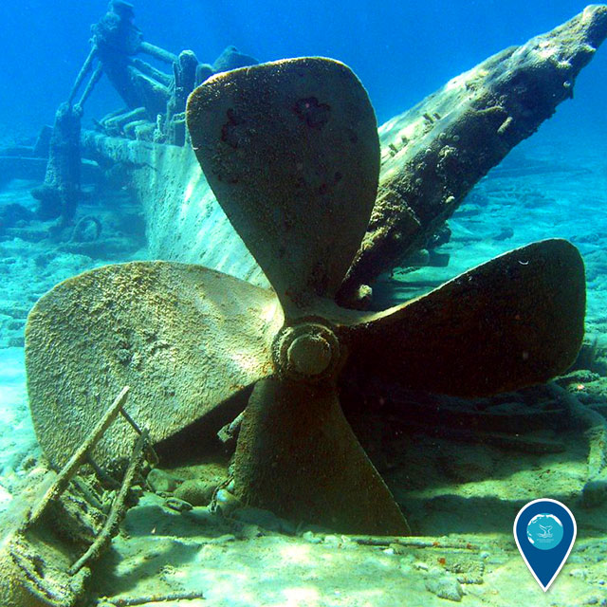
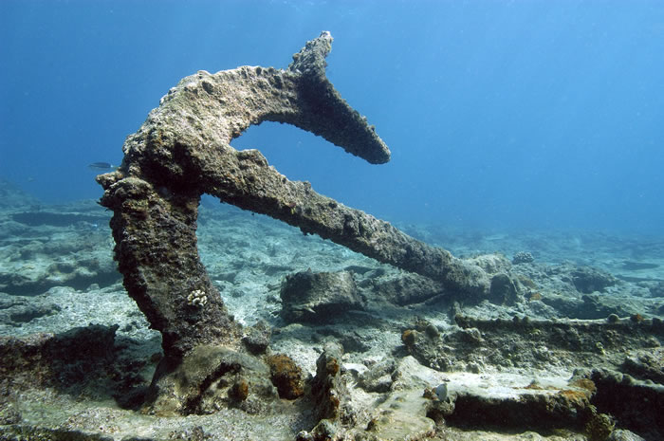
There are also shipwrecks and other cultural resources in many of the national marine sanctuaries which are kept safe in sanctuary waters where they can be studied over time.
Image source: NOAA
Image source: NOAA
Image source: NOAA

Slide 18
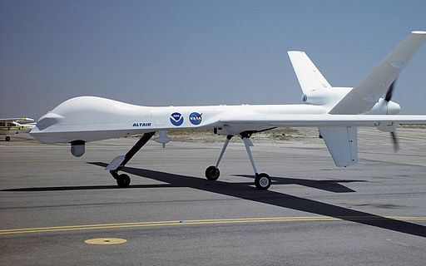
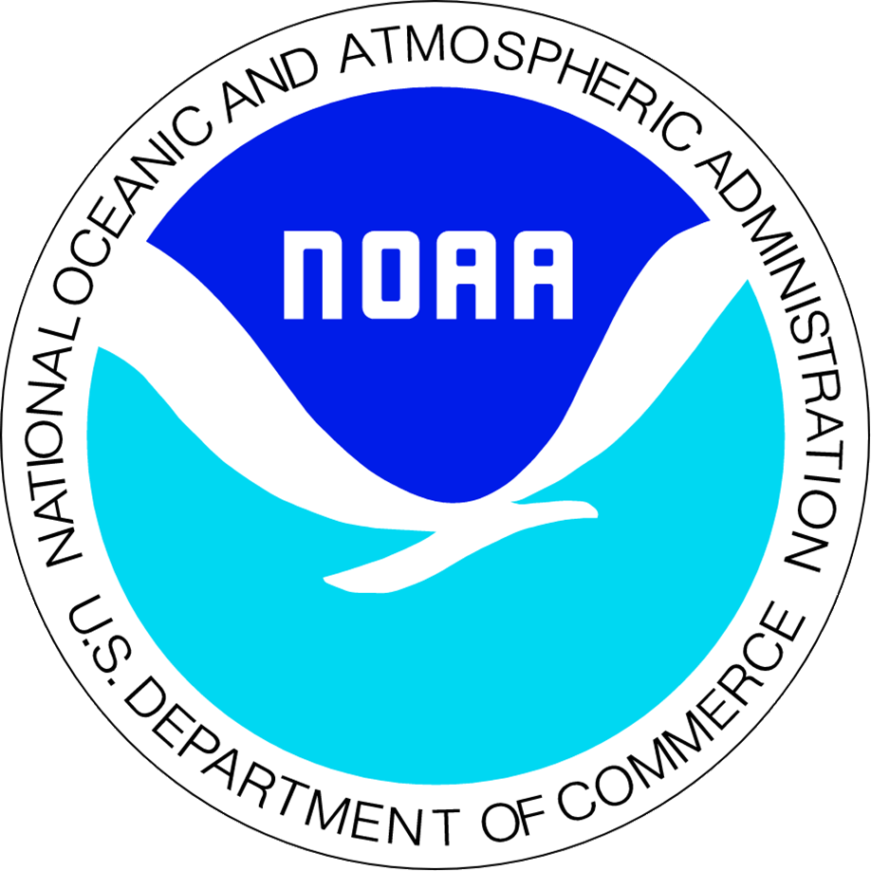
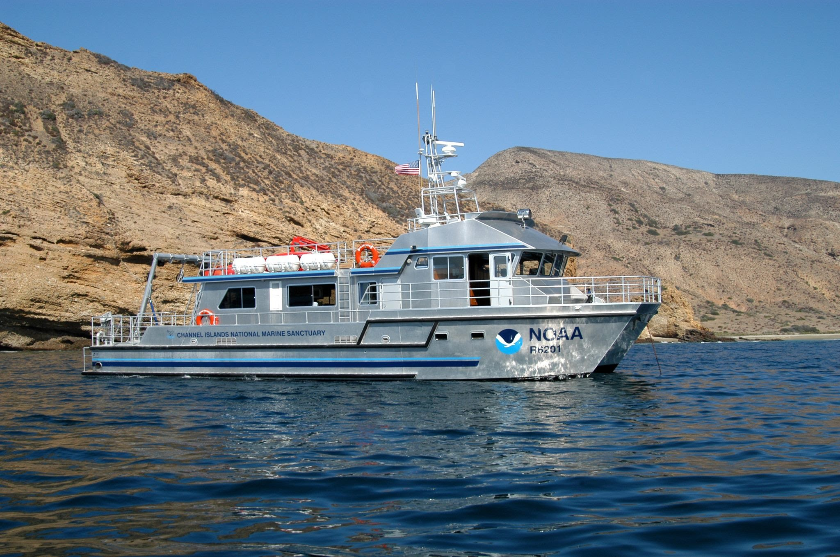
Image source: NOAA
Image source: NOAA
National Marine Sanctuaries are run by a government agency called NOAA.
NOAA stands for the National Oceanic and Atmospheric Administration,
but everyone calls it NOAA (pronounced like “Noah”).
The people who work for NOAA study our climate and weather as well as the ocean.

Slide 19
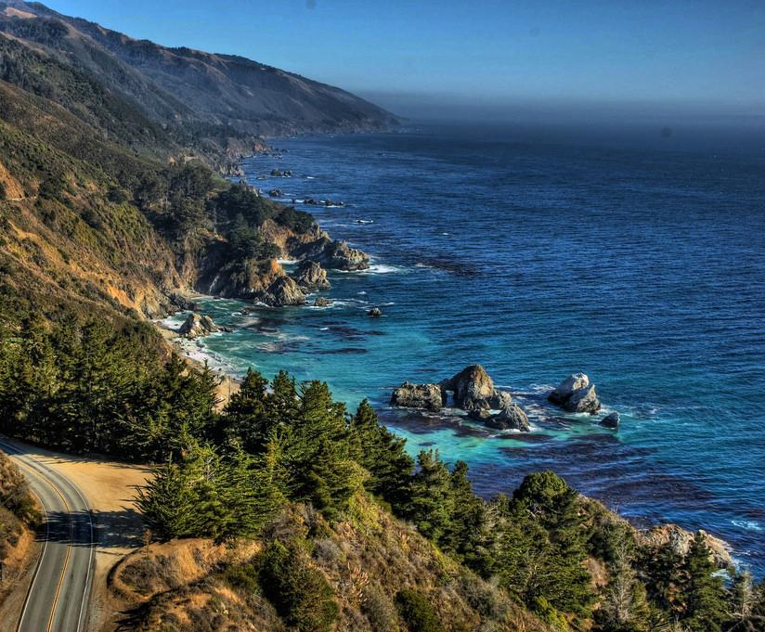
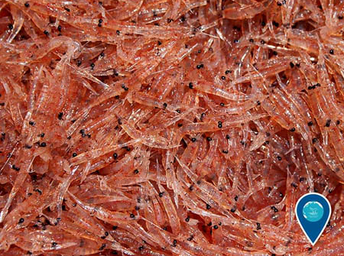
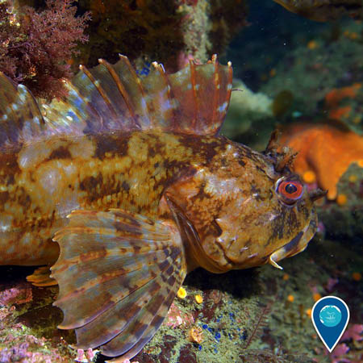
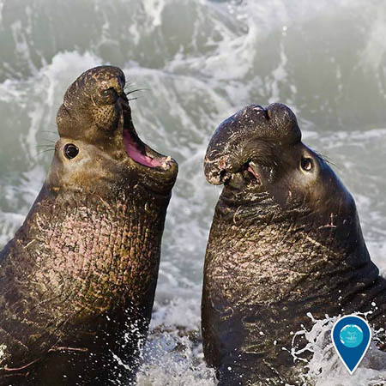
Take a look beneath the ocean’s surface…
Krill
Image source: Shannon Lyday/NOAA
Cabezon
Image source: Chad King/NOAA
Image source: Mike Baird/NOAA
Image source: https://www.flickr.com/photos/joxur223/5019607320
Northern elephant seals
You will find magnificent organisms – small and large!

Slide 20
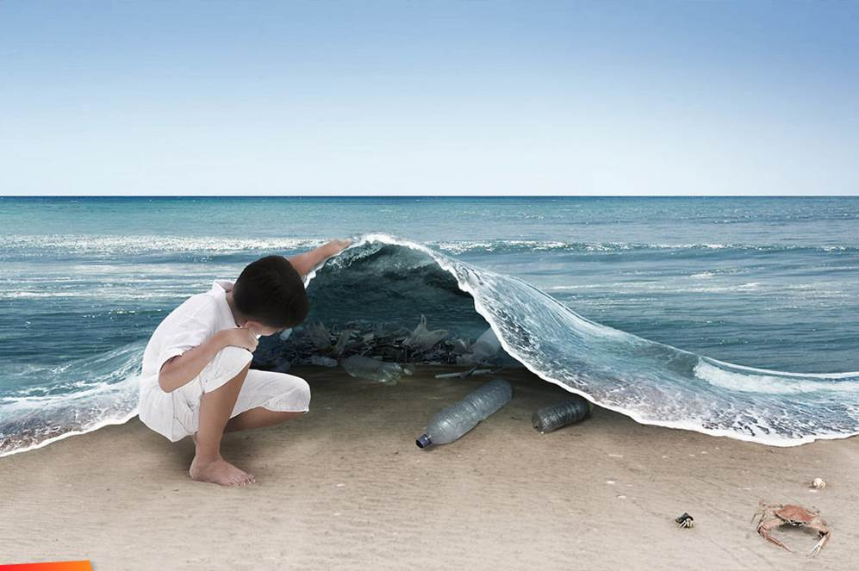
Image source: “What Lies Under” – Ferdi Rizkiyanto 2011
What else lies beneath the
ocean’s surface?

Slide 21
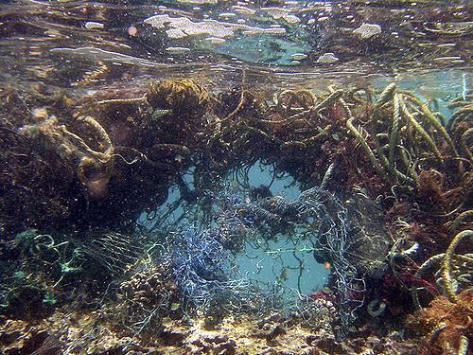
Marine Plastic Pollution – Global Scale
Marine Debris is a Global Environmental Issue
Trash can be found in all areas of the ocean, including…
Open Ocean
Deep Sea
Image source: http://news.nationalgeographic.com/content/dam/news/photos/000/682/68217.ngsversion.1422289469779.adapt.768.1.jpg
Image source: https://www.flickr.com/photos/usoceangov/4314177438
Remote Islands
Coastal Areas
Image source: http://architizer.com/blog/help-fund-whim-architects-island-made-entirely-of-coastal-trash/media/454736/
Image source: http://i.telegraph.co.uk/multimedia/archive/01391/plastic-kamilo_1391163c.jpg

Slide 22
Where does the trash come from?
An Introduction to Marine Litter
https://www.youtube.com/watch?v=DtfAhy2lgAA
Notes:
Video length: 2 minutes, 13 seconds

Slide 23
What are gyres?
Image source: http://www.cbc.ca/news2/interactives/ocean-garbage/gfx/five-gyres-map-940d.png
Learn more about the Great Pacific Garbage Patch: http://oceantoday.noaa.gov/trashtalk_garbagepatch/welcome.html

Slide 24
Once trash enters the ocean it has the potential to stay there for a very long time.

Slide 25
What is the difference between a macroplastic and a microplastic?
What is a macroplastic?
What is a microplastic?
Image source: https://upload.wikimedia.org/wikipedia/commons/a/a7/Plastic_pollution_083.jpg
Image source: http://cdn.phys.org/newman/gfx/news/hires/2013/microplastic.jpg
Large piece of plastic –
measuring greater than 5 mm in diameter
Small piece of plastic –
measuring less than 5 mm in diameter

Slide 26
The Issue with large pieces of plastic: Plastic Entanglement
Image source: http://theamericanenergynews.com/wp-content/uploads/2016/01/capodogliocoda252bsub-albertodarioromeo.jpg
Image source: https://www.emaze.com/@AFLWQQT/Plastic
Image source: https://s-media-cache-ak0.pinimg.com/564x/29/89/18/298918b975d5243fbe3307590271168a.jpg
Image source: http://www.b-e-a-c-h.org/marine_debris.html
Image source: http://plasticsbiology.weebly.com/uploads/4/7/7/9/47792045/6819470_orig.jpg
Marine animals often get tangled up in macroplastic litter – making it difficult for them to move or eat. Plastic entanglement can be deadly.

Slide 27
Plastic Ingestion
Image source: http://ichef.bbci.co.uk/news/1024/cpsprodpb/FF37/production/_85853356_plasticshukmanplankton2.jpg
Animals often mistake plastic litter for their natural food source – such as jellyfish, small fish, or krill. Organisms as small as plankton have been known to ingest plastic litter.
Once in their stomachs, plastic pieces can build up and cause blockages – making it hard for the animal to digest its food.
Image source: http://bioplasticintheocean.weebly.com/uploads/2/6/0/2/26021694/5974089_orig.jpg

Slide 28
How can plastic ingestion harm humans? Toxins, from plastic factory to fork
Plastic products are often made using harmful toxins
Scientists are currently studying if and how these toxins may be harmful to human health.
Once in the ocean, plastic particles can absorb more toxins from the surrounding environment
Image source: http://ww2.kqed.org/quest/wp-content/uploads/sites/39/2013/05/Rainbow-Runner_M-Eriksen.jpg
When fish ingest plastic particles, the toxins in the plastic are absorbed by their fatty tissues
These fatty tissues are what humans eat when we consume fish
Image sources: http://www.clipartkid.com/images/557/chemical-reaction-clipart-clipart-panda-free-clipart-images-h6RArx-clipart.png
http://clipartix.com/wp-content/uploads/2016/05/Waves-sea-wave-clipart.png
http://files.focusky.com.cn/web/demo/economic-theories/files/extfiles/ext_02015514163119737.png
http://pngimg.com/upload/fork_PNG3067.png
http://www.mes-conference.ru/images/awards/questionMark.gif

Slide 29
Journey to microplastics
How do big plastic pieces break down?
Image source: http://clipartix.com/wp-content/uploads/2016/04/Sunshine-sun-clipart-free-clipart-images-2.png
Image source: https://static.independent.co.uk/s3fs-public/thumbnails/image/2014/07/12/20/14microbeads.jpg
Image source: http://www.clipartkid.com/images/198/americanos-ZM7CCC-clipart.png
Image source: http://clipartix.com/wp-content/uploads/2016/05/Sea-waves-clipart.png
When plastic litter interacts with waves and sunlight it breaks down into tiny little pieces.

Slide 30
Plastic Microbeads
Have you seen these?
Image source: https://assets.rbl.ms/6474152/980x.jpg
Plastic microbeads are found in many cosmetic products such as face wash and toothpaste.
These tiny little beads are designed to wash down the drain, but where do they go after that?
https://youtu.be/Bic7QEVRNe4
Notes:
Video length: 4 minutes, 35 seconds

Slide 31
What can
YOU
do?
Image source: http://fiveoclockstop.com/wp-content/uploads/2016/03/pointing_finger.png

Slide 32
SEA Change Science, education, action
https://www.youtube.com/watch?v=Vfx6WSrnlqw
Notes:
Video length: 3 minutes, 40 seconds

Slide 33
Start with: Going green, and thinking blue!
What we do on land has a direct impact on our local watersheds and ocean.
What can you do on land to better protect marine environments?

Slide 34
Take the Zero Waste Week Challenge
Pledge to reduce waste at your school, in your community and at home!

Slide 35
What is Zero Waste?
“Zero Waste means designing and managing products to eliminate the amount of trash that is sent to the landfill or burned.”
- Zero Waste International Alliance
Image source: https://www.texasenvironment.org/wp-content/uploads/2015/04/zerowaste1.png

Slide 36
Reduce Waste at Your School
Step up your recycling and composting efforts
Replace single-use condiment packets with bulk dispensers
Replace spork packs with bulk utensil dispensers
Replace plastic straws with paper straws
Power down all electronic devices when not in use
Image source: http://www.webstaurantstore.com/images/products/main/7456/24188/carlisle-38504-condiment-dispenser-rail-with-4-standard-pumps.jpg
Image source: https://static.grainger.com/rp/s/is/image/Grainger/6ZCP8_AS01?$mdmain$
Image source: http://www.blakescakeandcandy.com/home.php?cat=610

Slide 37
Start in your cafeteria:
Encourage students to take only what they need
Place recycling bins in areas where trash is often found
Create a share bin: where students can leave items that they did not eat for others to take

Slide 38
Make Art NOT Trash!
Bottle Cap Mural at Carmel River School – Carmel, CA
Art projects are a great way to spread the message about going green, and thinking blue! Use trash found on your campus to create a captivating mural.

Slide 39
Reduce Waste in Your Community
Ways to keep your community clean:
Participate in a beach, river, or park clean-up
Reach out to local restaurants to encourage them to reduce their waste
Straws are a great place to start – encourage local restaurants to serve straws only upon request
Write to your local government officials to inspire them to take action
Spread the word about zero waste to your friends and family members
Remember: change in your community starts with YOU.
Set an example for your peers by keeping your community free of debris!
Image source: http://yovenice.com/wp-content/uploads/2015/07/Beach-Clean-Up-July-5th.png
Image source: http://www.baycrossings.com/admin/HTML/upload/download/1856c_chiu_talking_at_rally.jpg
Image source: NOAA Marine Debris

Slide 40
Reduce Waste at Home
Image source: http://www.clipartfinders.com/clipart/67/good-neighbor-policy-ndash-the-san-diego-real-estate-dad-perspective--67391.gif
You and your family members can take similar steps to reducing waste in your home by: using less plastic products, repurposing items before throwing them away, recycling, and choosing to use reusable items…

Slide 41
Refuse Single-use Plastics
Image source: http://cen.acs.org/content/dam/cen/92/37/09237-cover-plasticbag.jpg
Image source: http://cen.acs.org/content/dam/cen/92/37/09237-cover-plasticbag.jpg
Image source: http://clubamenities.com/10-oz-dixie-clear-plastic-cup/
Image source: https://www.packari.com/out/pictures/master/product/1/902104_S00020.jpg
Image source: http://www.heraldplastic.com/media/wysiwyg/0271DISP.jpg
Image source: https://recycle2011.files.wordpress.com/2011/04/styrofoam2.jpg

Slide 42
Choose Reusable Items!
Image source: http://gogreentravelgreen.com/best-reusable-drinking-straws-kids/
Image source: http://mightynest.com/sites/mightynest.com/files/imagecache/product_preview/to-go-ware-utensils.jpg
Image source: http://www.turbosquid.com/3d-models/3d-reusable-aluminium-water-bottle/816913
Image source: http://www.apparelnbags.com/ultraclub/r3000-reusable-shopping-bag.htm
Image source: http://assets.inhabitots.com/wp-content/uploads/2010/11/PLANETBOX-with-food-and-dippers.jpg

Slide 43
Reducing your plastic consumption helps to reduce your carbon footprint!
Image source: http://today.ttu.edu/images/2013/05/Pump2-med.gif
Image source: http://www.industrialaccess.com/blog/wp-content/uploads/2016/02/oil-refinery.jpg
Image source: https://i.ytimg.com/vi/q42nJRlwtyo/hqdefault.jpg
What is a carbon footprint?
The amount of carbon dioxide emitted by the use of fossil fuels
Reducing the amount of plastic we produce and consume reduces your carbon footprint!
A lot of energy and resources go into producing plastic products from:
Extracting oil
Transporting the oil by ship, plane, or truck
Processing the oil in a refinery
Producing the plastic in a factory
Shipping the plastic products to stores

Slide 44
Reducing your energy use is another great way to reduce your carbon footprint at school, in your community, and at home.
Start by powering down your electronic devices and turning off lights when not in use – a little bit of effort goes a long way!
To calculate your carbon footprint:
http://www.nature.org/greenliving/carboncalculator/

Slide 45
YOU have the power to make a change…
https://www.ted.com/talks/melati_and_isabel_wijsen_our_campaign_to_ban_plastic_bags_in_bali?language=en
Image source: https://www.ted.com/talks/melati_and_isabel_wijsen_our_campaign_to_ban_plastic_bags_in_bali
Melati and Isabel Wijsen are teenage activists that launched the campaign “Bye Bye Plastic Bags.”
YOU can be the change too!
Notes:
Video length: 11 minutes

Slide 46
Stories from Zero Waste Week 2016… Franklin High School – Elk Grove, CA
“It’s our plastic, it’s our problem” was Franklin High School’s driving motto for Students for Zero Waste Week 2016! During their Zero Waste Week, the Plastics Club worked to reduce single-use plastic water bottles on campus. Club members approached their goal with a variety of activities including selling student-designed reusable water bottles while placing environmental impact stickers on all single-use plastic bottles sold at the student store. Students also encouraged their peers to sign pledges to use their reusable bottles and created a petition for more water bottle refill stations to be installed in their school district. At the end of the week, data revealed a very successful campaign – Franklin High School experienced a 67% DECREASE in the sales of single-use water bottles and a 60% INCREASE in the use of the refillable water bottle stations on campus!

Slide 47
Stories from Zero Waste Week 2016… Lupelele Elementary School – Pago Pago, American Samoa
“I pledge allegiance to the Zero Waste Week campaign that under any circumstances I will do my best to keep American Samoa beautiful…” With their zero waste week pledges, students at Lupelele Elementary School worked together to inspire their peers to clean up school grounds and to make every week a Zero Waste Week! They designed and distributed colorful student-made Zero Waste Week posters, conducted a campus clean-up, and created many opportunities for students to talk to one another about the impact of waste on their island community. In addition, they all brainstormed ways they can work together to keep their home beautiful and safe for future generations.

Slide 48
Stories from Zero Waste Week 2016… St. Francis High School – Watsonville, CA
The Ecology Club led the way for St. Francis High School’s Zero Waste Week. With the help from local organizations and businesses (Save the Earth, O’Neill Sea Odyssey, the Last Plastic Straw, and Sandbar Solar Company), the week was filled with events, challenges, social media games, and educational presentations. As a real test, the entire school unplugged for a “Zero Energy Day”. By turning off all lights, computers, WIFI, and other electronics - students reflected on their dependency as well their ability to do without! To top off the week, St. Francis collaborated with Save the Earth Foundation and held the first EVER Save the Earth video competition. Go to www.savetheearth.org to view these inspiring student videos!

Slide 49
Stories from Zero Waste Week 2016… All Saints’ Day School – Carmel, CA
All Saints Day School was a buzz with a number of activities during their Zero Waste Week campaign. For example, second grade students created a “Recycle City” where they reimagined and rebuilt cities using recycled and repurposed materials. All Saints’ Fifth graders participated in beach clean-ups at Carmel Beach as well as conducted a waste audit on campus. The entire school community was invited to share their ideas for next year’s Zero Waste Week by adding their Zero Waste Week Post-its on a “Zero Waste Challenge” board. Overall, All Saints worked hard to grow their “Zero Waste WEEK” into a “Zero Waste WAY”!

Slide 50
To learn more about
Students for Zero Waste Week…
Visit the
Students for Zero Waste Week
Webpage: http://sanctuaries.noaa.gov/education/ocean_guardian/zero-waste-week/
Check out the
Students for Zero Waste Week Video:
https://youtu.be/HDkK6YwmcjA

